Slide 1

Microsoft 365 platform community call
aka.ms/m365pnp
Your host in this call: Brian T. Jackett
May 31, 2022

Slide 2




Agenda
Latest updates and news on the Microsoft 365 platform
Group picture time with Together Mode!
Demos
Luis Ramos Vea, Rabeb Othmani – Latest on Microsoft Graph developer portal updates
Vesa Juvonen – Build 2022 key announcements for Microsoft 365 platform
David de Matheu – Get started with UI Library for Azure Communication Services - Rescheduled for later

Slide 3
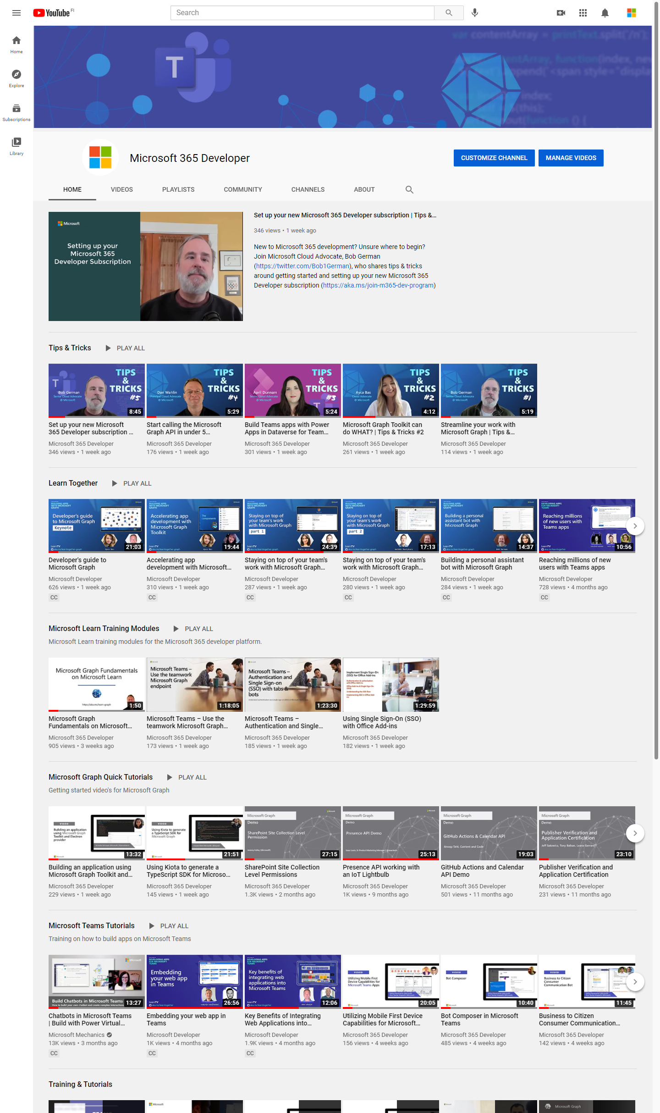
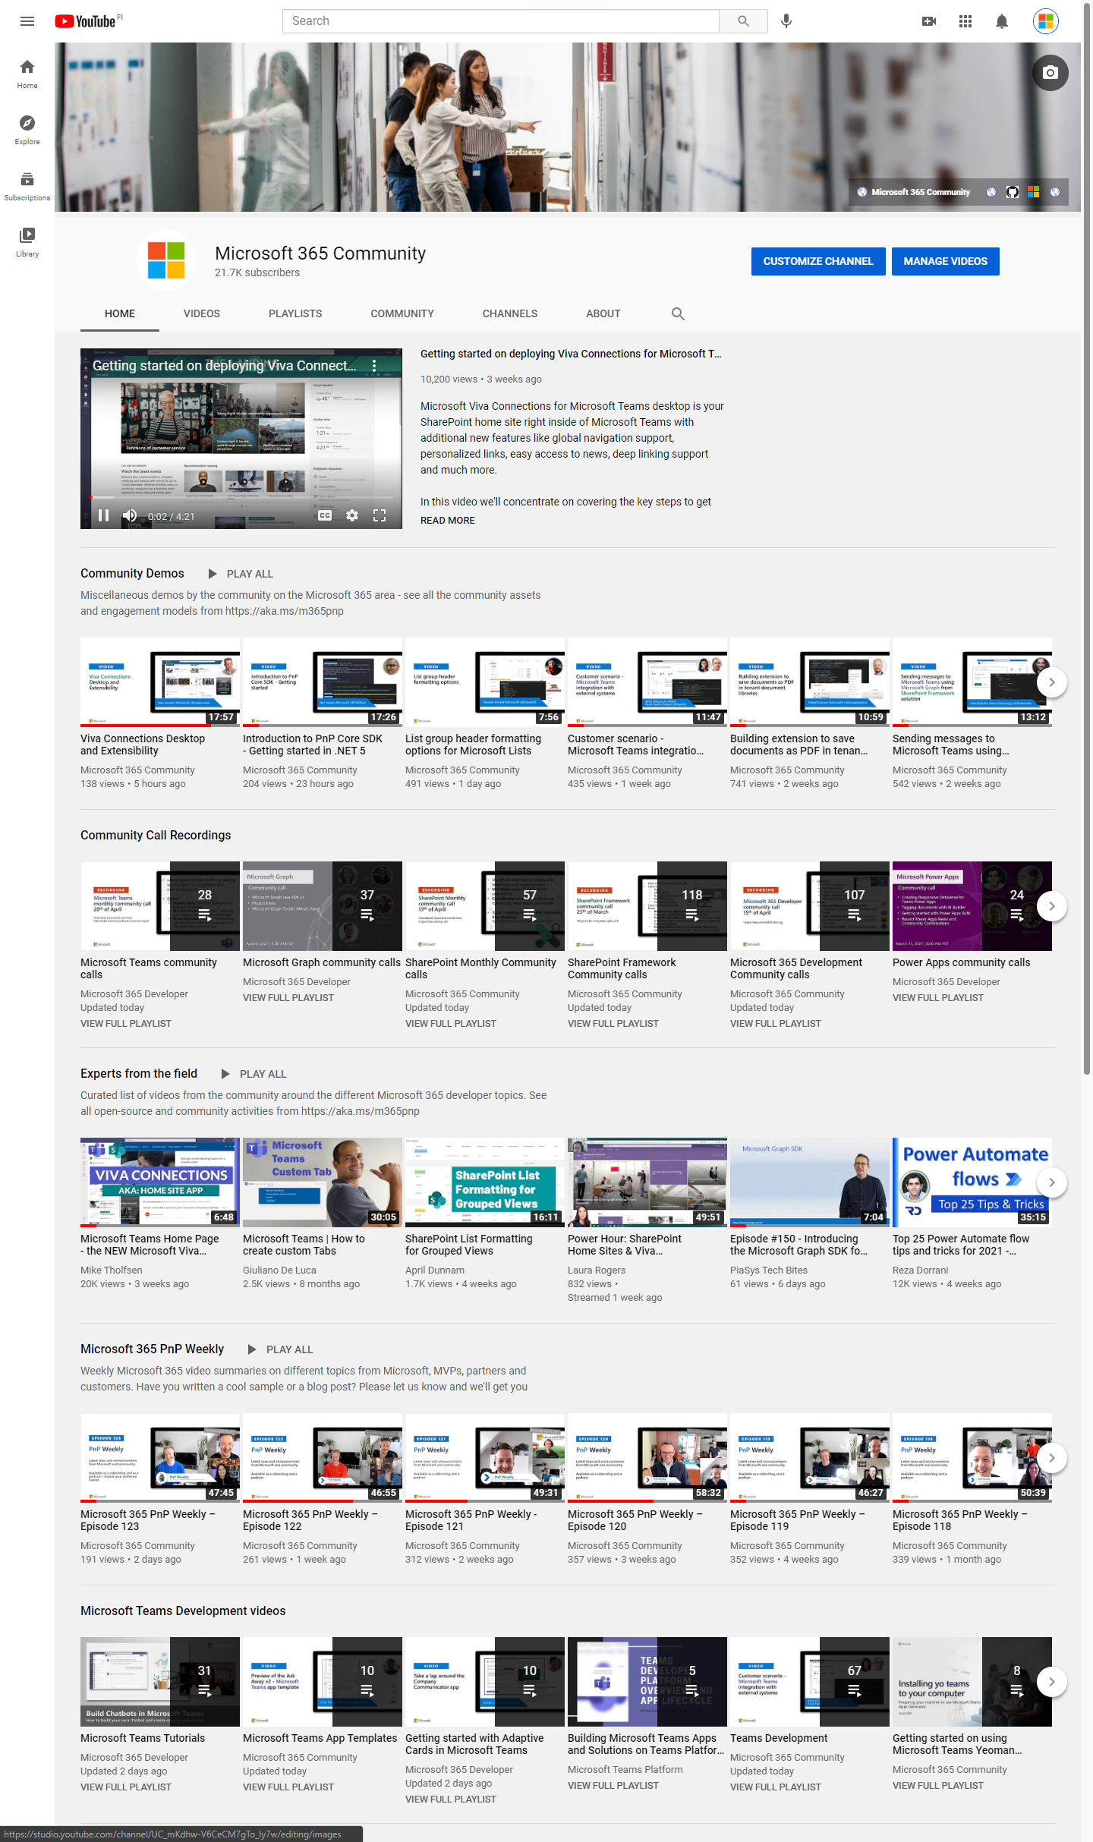
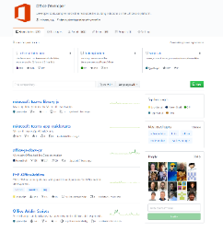
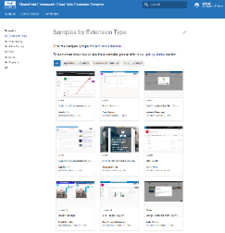
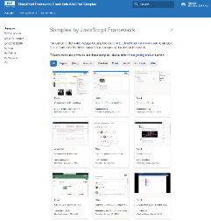
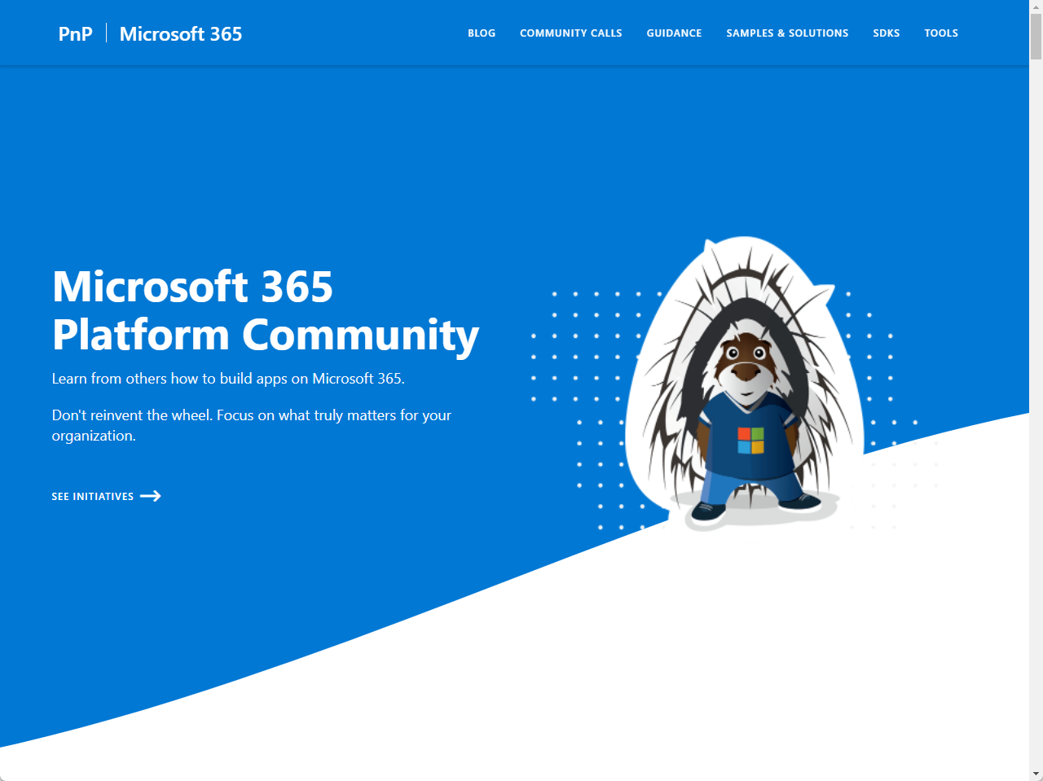
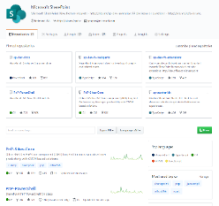
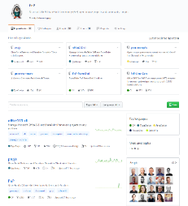
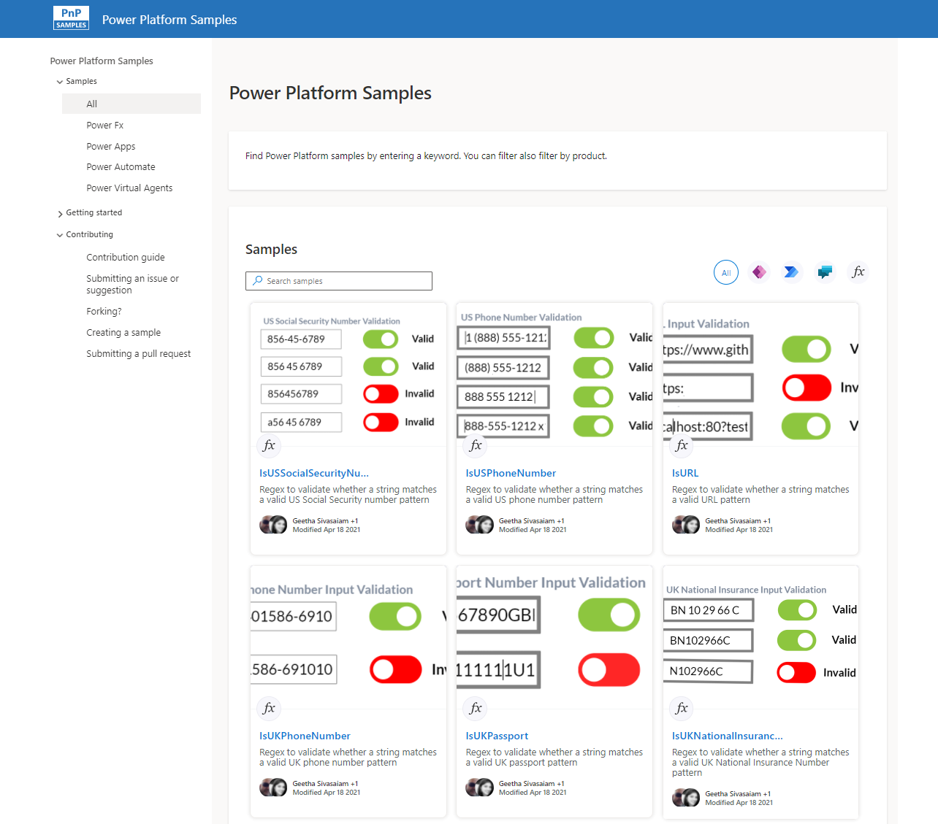
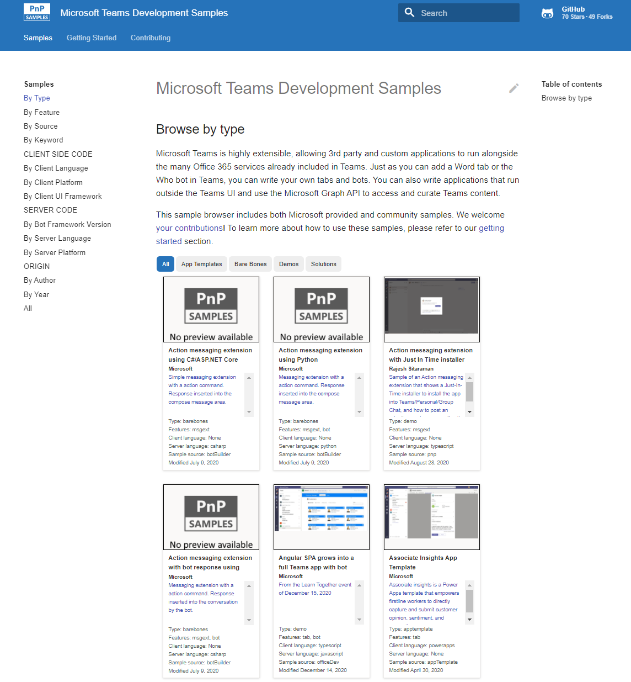
Microsoft 365 developer videos
Microsoft 365 community videos
Open-source
Sample galleries
Open-source initiatives and samples
aka.ms/m365devyoutube
aka.ms/m365/videos
github.com/pnp
github.com/officedev
github.com/sharepoint
github.com/microsoftgraph
aka.ms/m365/samples
aka.ms/teams-samples
aka.ms/spfx-webparts
aka.ms/powerplatform-samples
aka.ms/spfx-extensions
aka.ms/list-formatting
aka.ms/m365/community
@Microsoft365Dev | @m365pnp

Slide 4
Microsoft 365 developer community calls
Microsoft 365 platform (weekly) https://aka.ms/m365-dev-call
(Notice. This call is on a summer break between July 1st and 31st of August 2022)
Adaptive Cards https://aka.ms/adaptivecardscommunitycall
Microsoft identity platform https://aka.ms/IDDevCommunityCalendar
Office Add-ins https://aka.ms/officeaddinscommunitycall
Power Platform https://aka.ms/PowerAppsMonthlyCall
Microsoft 365 and Power Platform community (bi-weekly) https://aka.ms/m365-dev-sig
Viva Connections & SharePoint Framework (bi-weekly) https://aka.ms/spfx-call
Download recurrent invites from
https://aka.ms/m365/calls
Notes:
m365-dev-sig

Slide 5
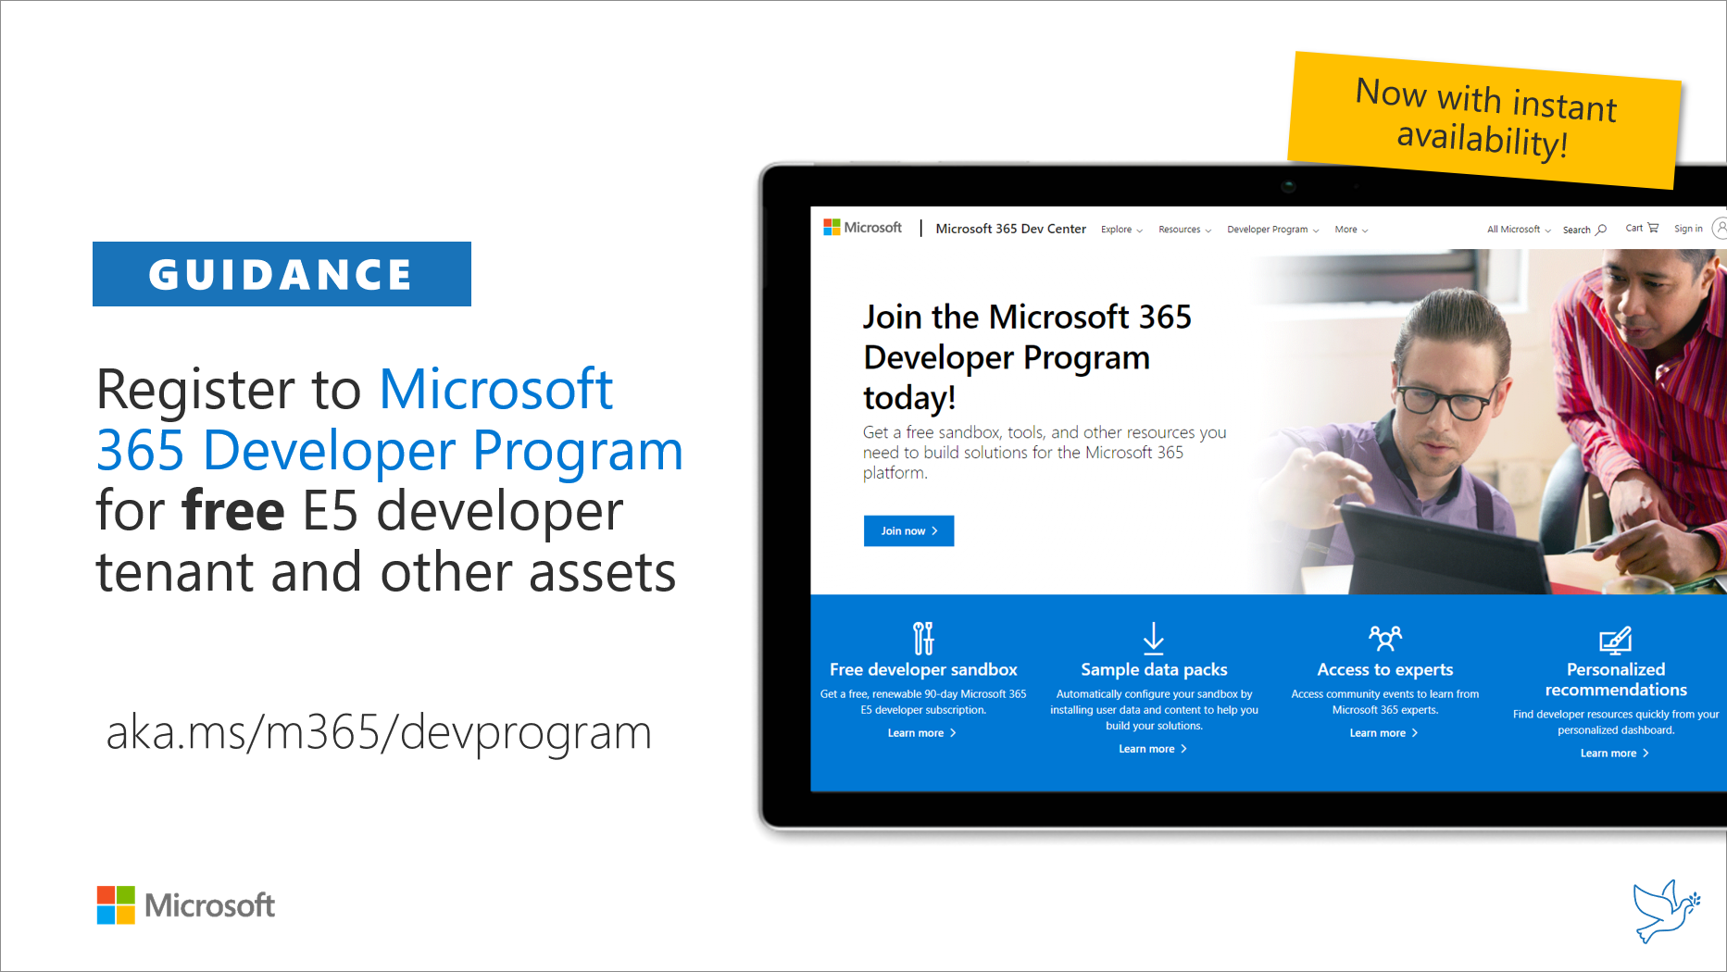
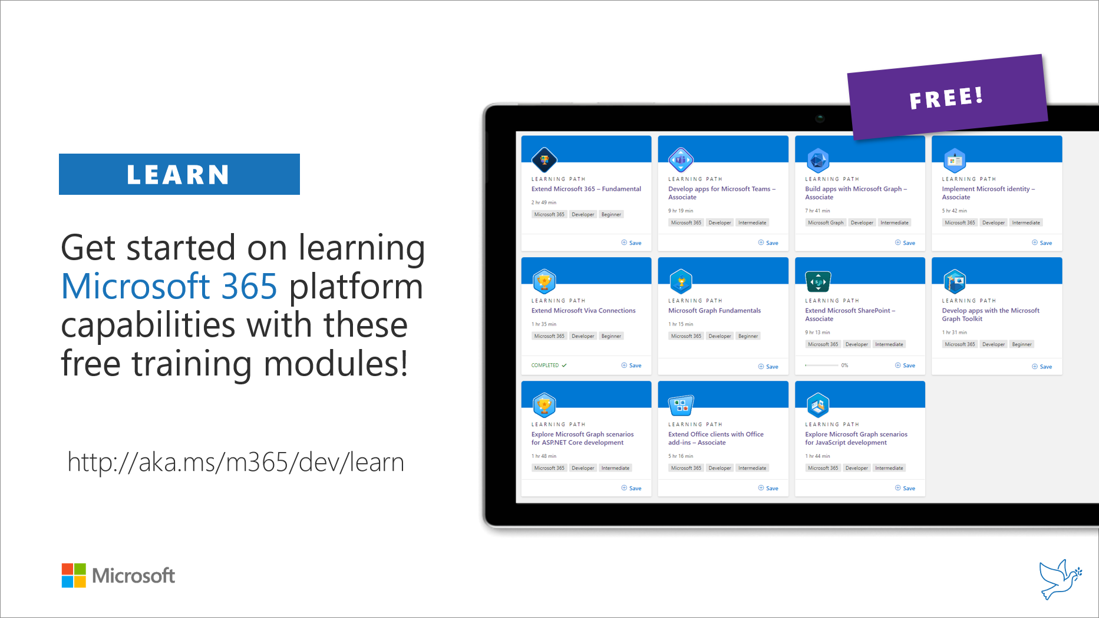
Getting started assets for Microsoft 365 dev
aka.ms/m365/devprogram
aka.ms/m365/dev/learn

Slide 6

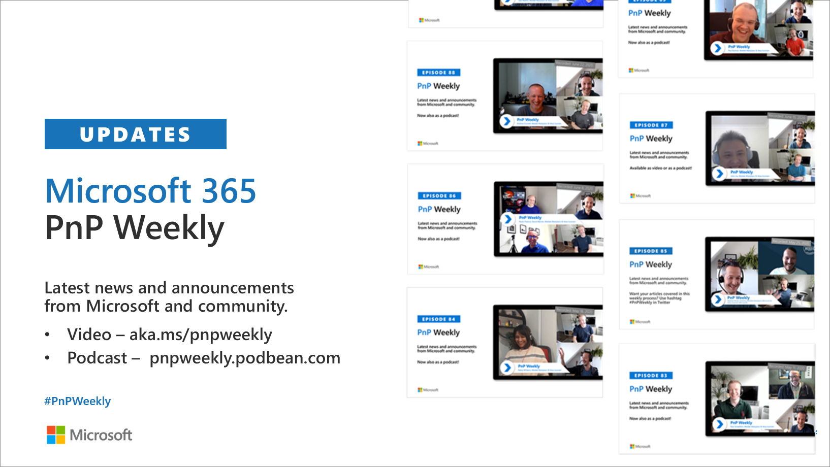
Microsoft 365 Developer podcasts
m365devpodcast.com
Video – aka.ms/pnpweekly
Podcast – pnpweekly.podbean.com

Slide 7

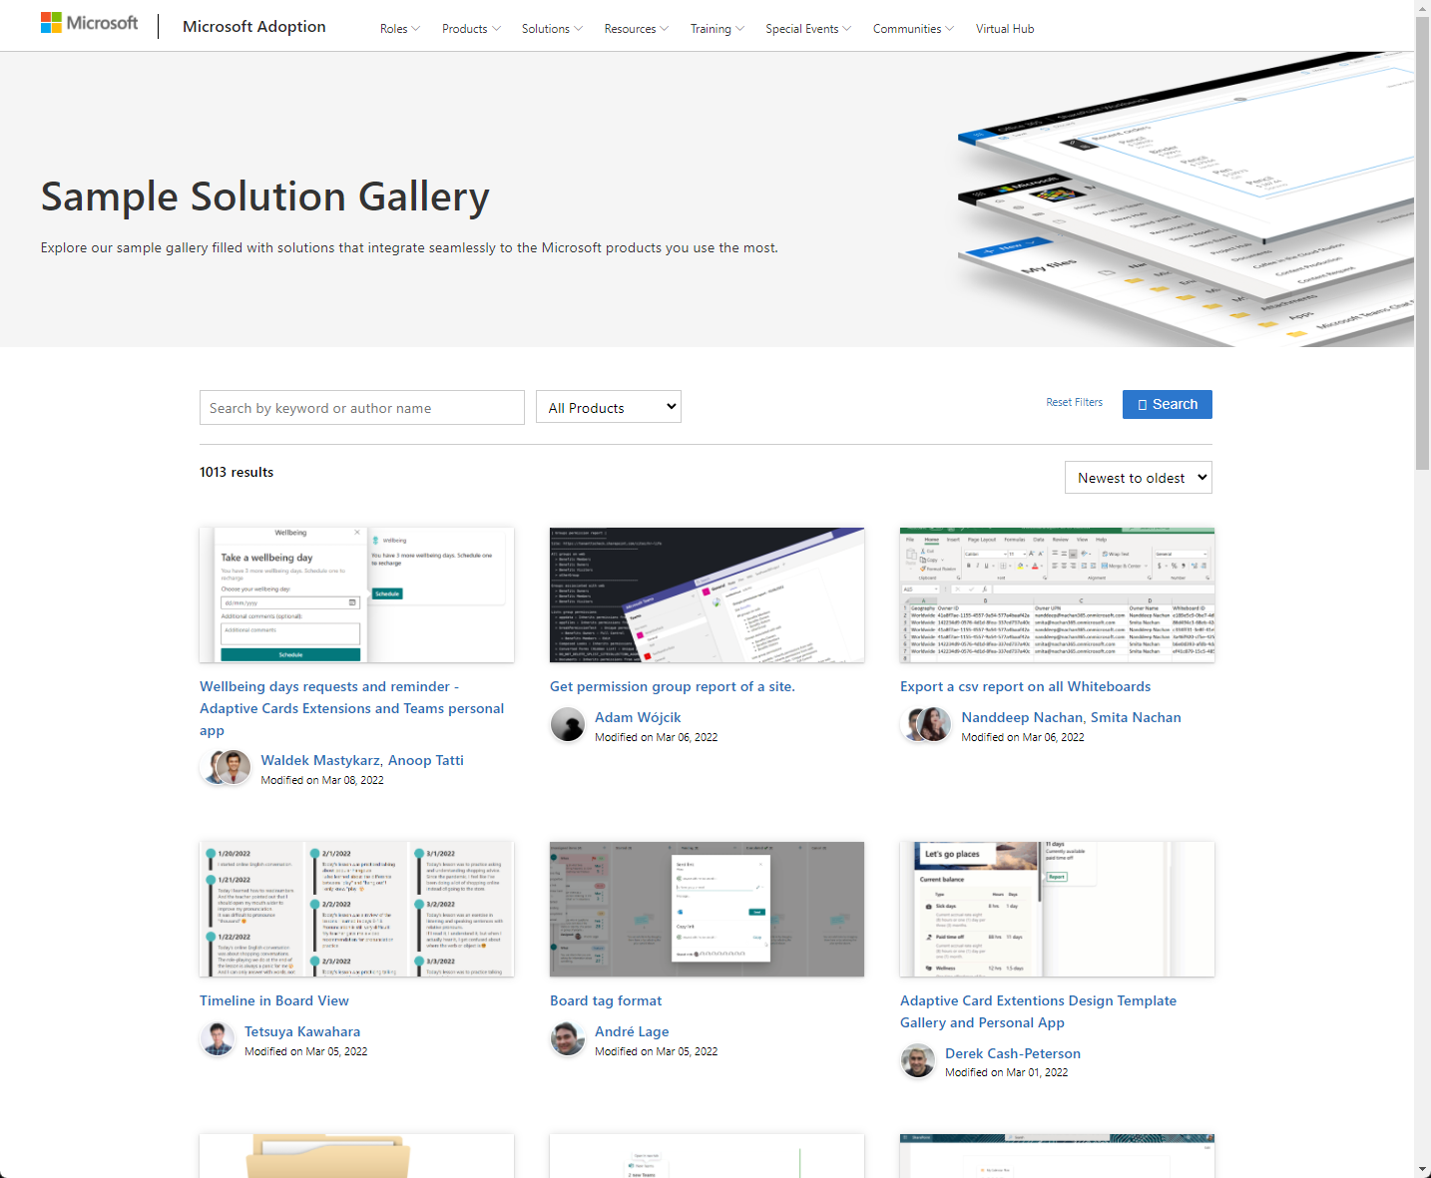
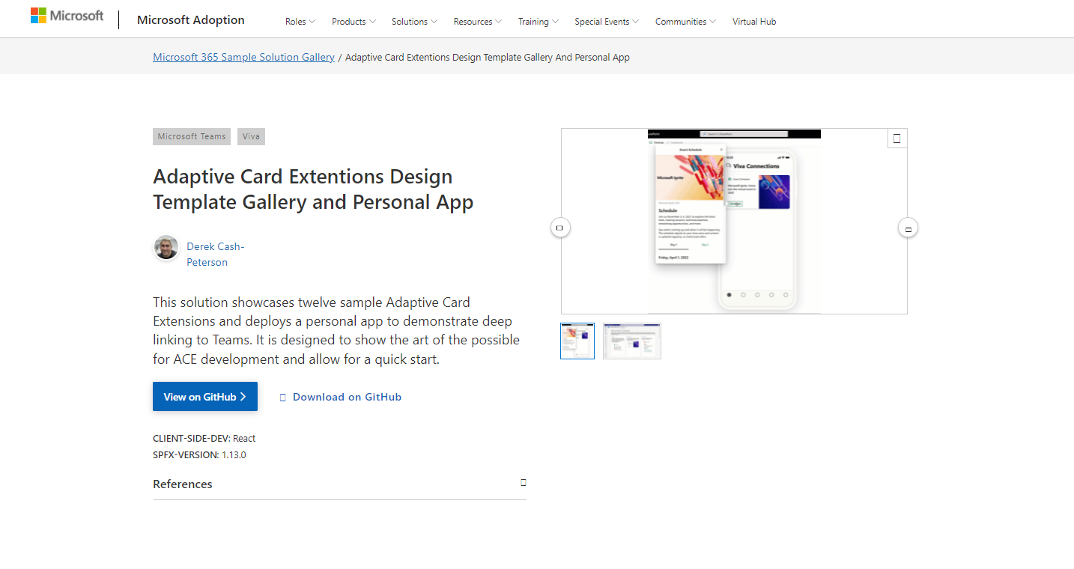
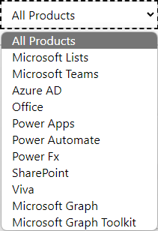

SAMPLES
New Microsoft 365 sample gallery with more than 500 samples from Microsoft and community
1080
aka.ms/m365/samples

Slide 8

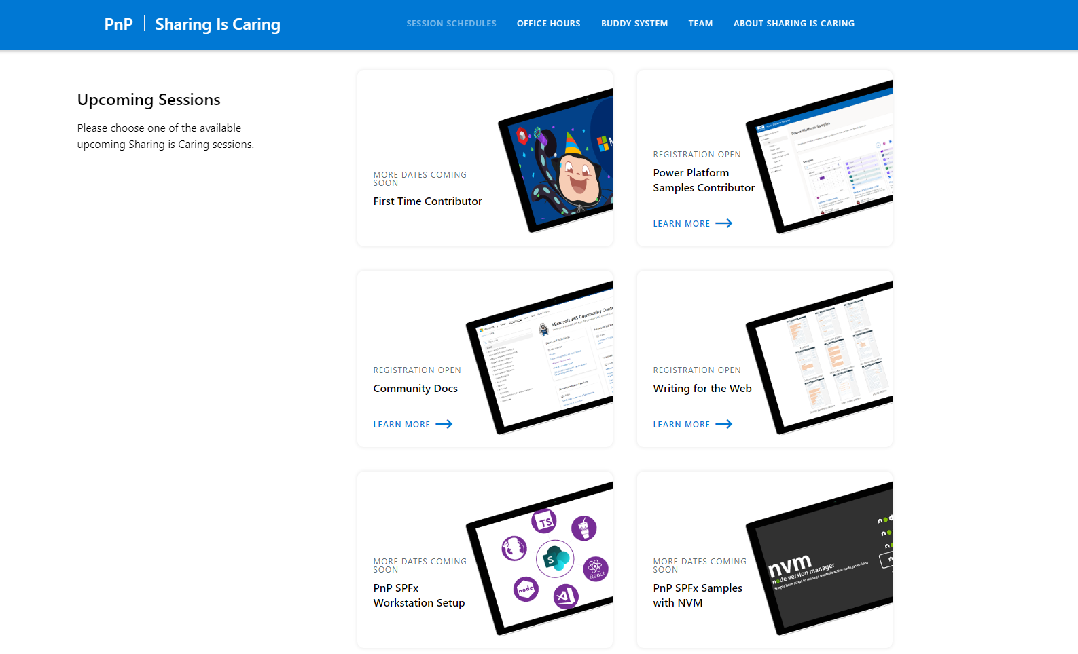
GUIDANCE
Learn how to get started in the open-source PnP community!
Upcoming Sessions:
General First Time Contributor
Power Platform Samples Contributor
Community Content Docs
Writing for the Web
SPFx Developer Workstation Setup
Using PnP SPFx samples w/ NVM
More than code with VS Code
First-time presenter
M365 Maturity Model Practitioners
Power Platform - Power Pages – Coming Soon!!!
https://aka.ms/sharing-is-caring
Notes:
25 Total attendees, 16 attendees who attended both First-Time Contributors and Community Docs sessions.

Slide 9

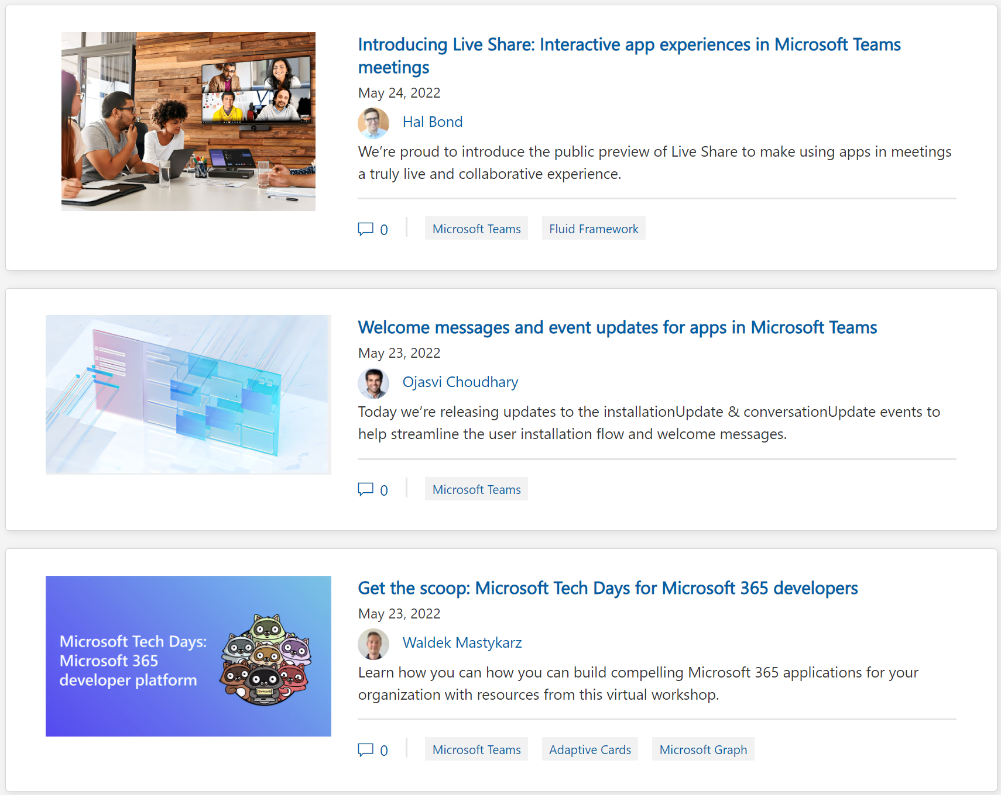
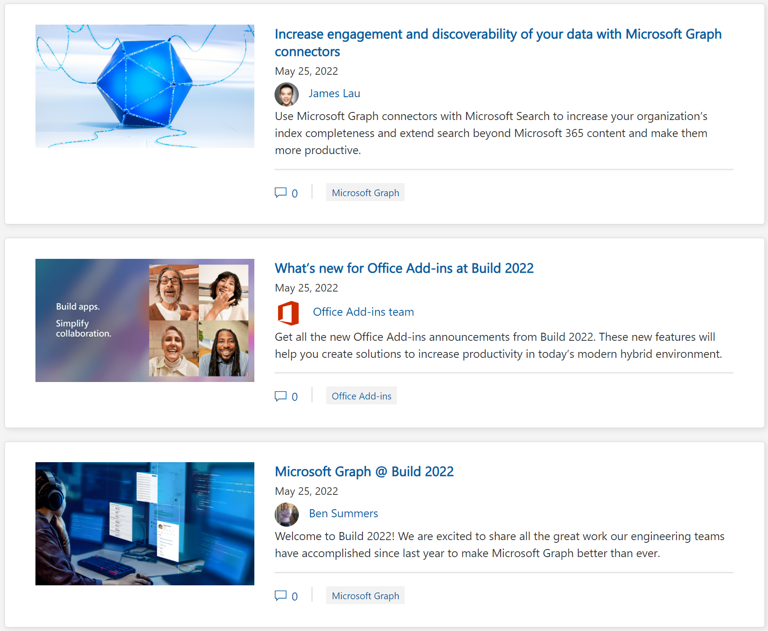
https://aka.ms/m365dev/blog
https://aka.ms/teams/blog
https://aka.ms/microsoftviva/blog
Notes:
Live Share is built on Fluid Framework and Azure Fluid Relay. Media synchronization while still having local playback customization.
Welcome message updates allows sending welcome message to custom channel, not just “General” as well as additional events to interact with.
2-hour virtual event with Microsoft FTEs and MVPs to learn about building applications on M365 platform.
Graph connectors updates with new 1st party connectors, increased scale, integration with Context IQ, and Graph connector SDK.
Access connector for Dataverse and Power Platform. New APIs and resources for Office Add-in JavaScript API. Preview creating Outlook add-in with Teams manifest.
MGDC updates on datasets and integrations with Azure Synapse and Purview. Teams channel and chat message API updates. Preview of Approvals APIs. Updated Graph developer portal. Kiota is not GA. Graph learning path.

Slide 10
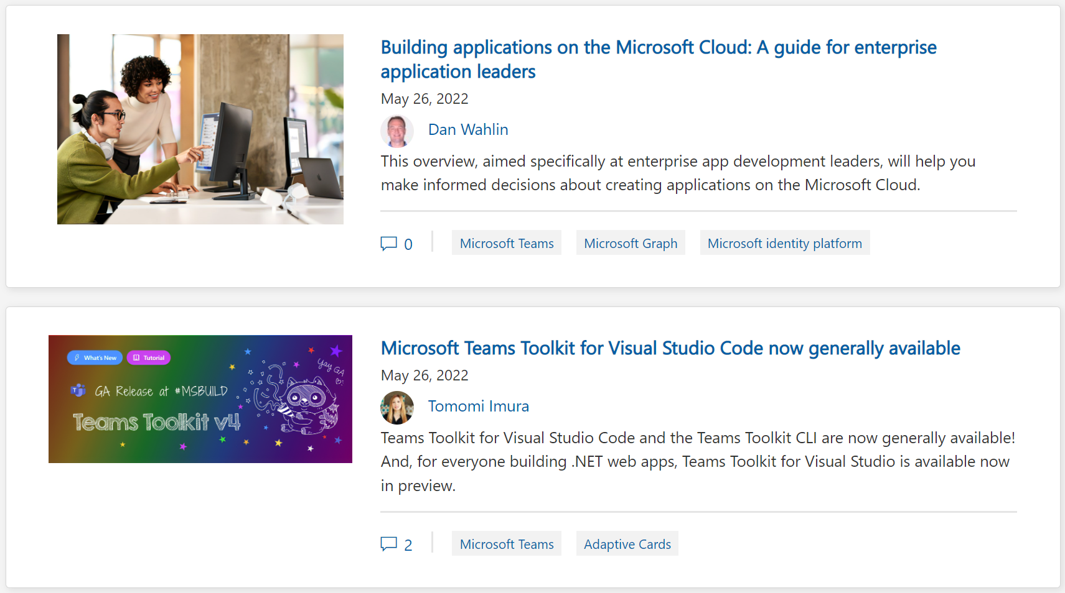
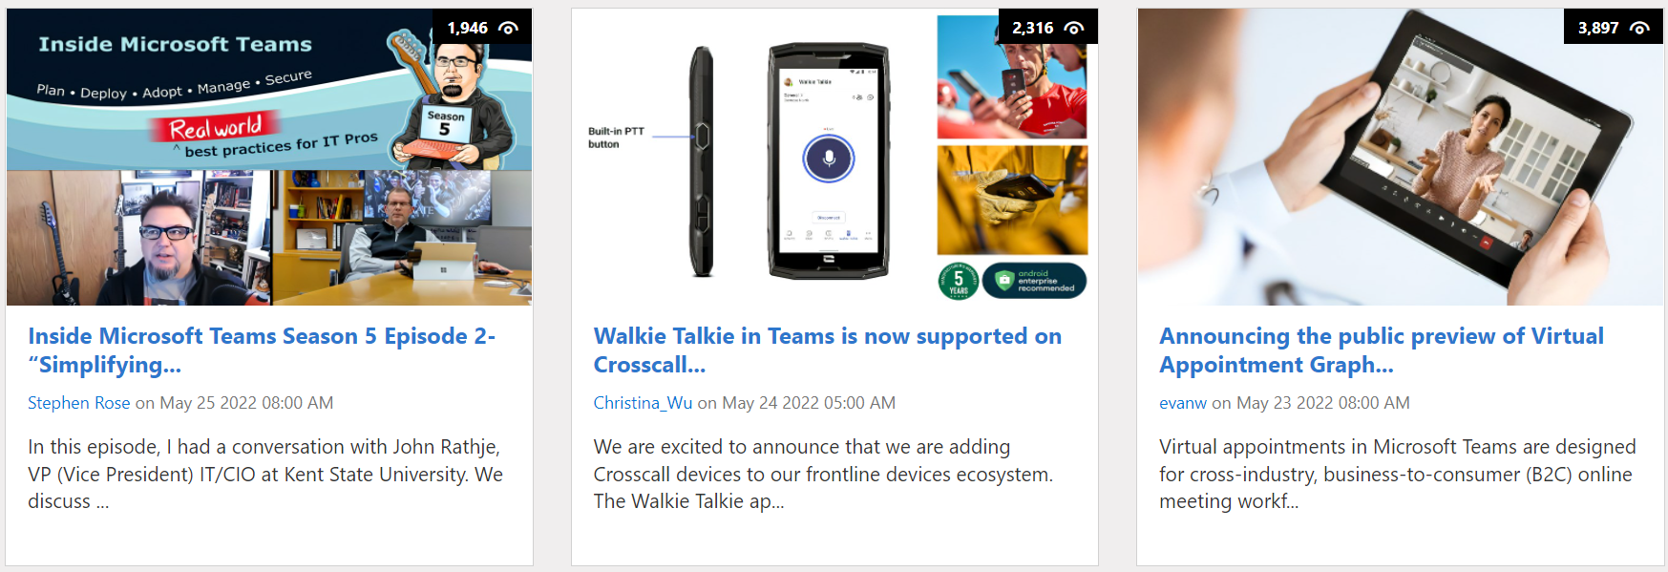
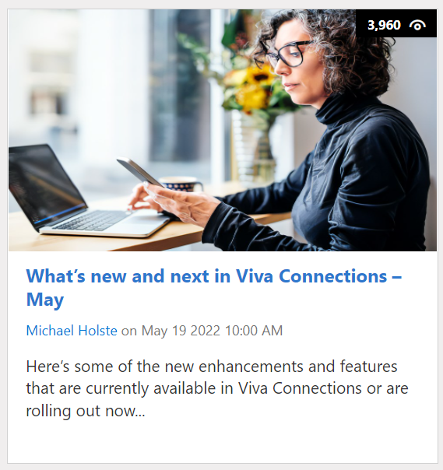
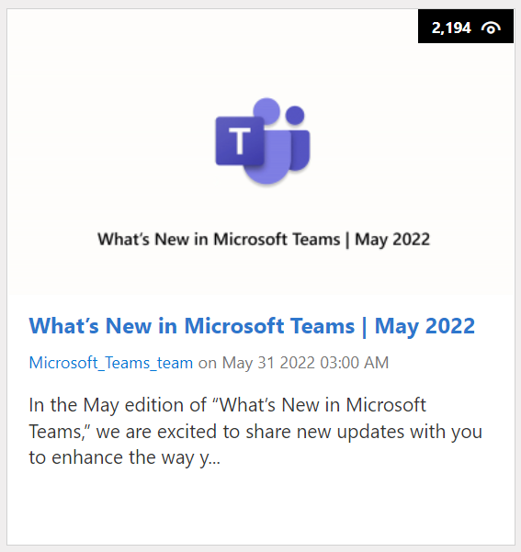
https://aka.ms/m365dev/blog
https://aka.ms/teams/blog
https://aka.ms/microsoftviva/blog
Notes:
Guide for application leaders to visualize and make decisions for creating applications on Microsoft Cloud.
Teams Toolkit is VS Code now GA. Scenario based templates. Teams UI component library.
Viva Connections Multilingual dashboard, Top News card, improved ranking and personalization, sample gallery, and more. Also many new 3rd party integrations.
Crosscall devices now support walkie talkie with dedicated push to talk button.
Virtual Appointment API coming to preview to support B2C scenarios. Sign up for the preview.
Discussion with Kent State University on improving productivity with Teams, Power Platform, and bots.
Teams app available in Windows Store, device integrations, VDI features, education and frontline enhancements, and new releases to GCC clouds.

Slide 11
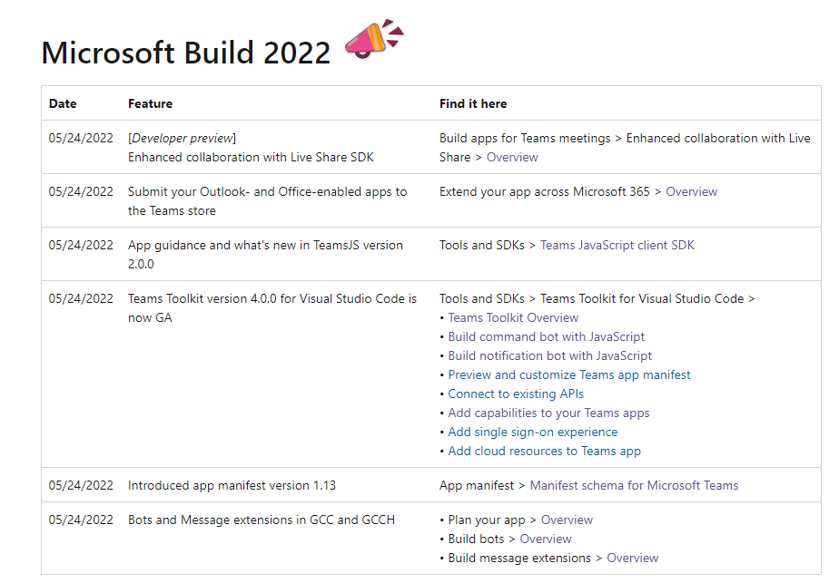
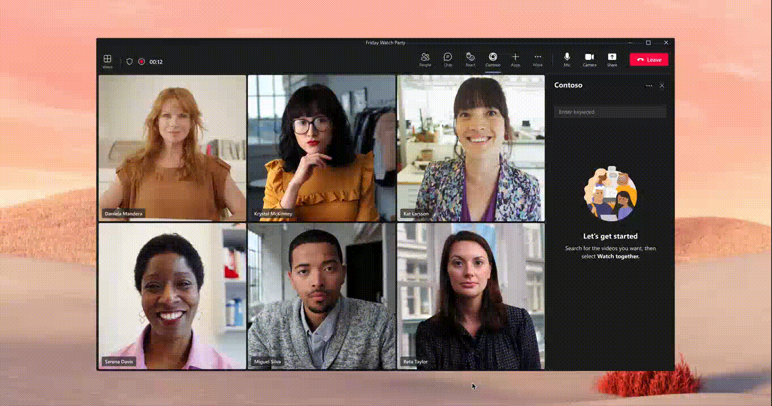






Teams Platform and Doc updates
Microsoft Build 2022 updates
1
Live share SDK demo
http://aka.ms/TeamsDevDocs > What’s new?
http://aka.ms/TeamsDevDocs > Extend your app across Microsoft 365 > Overview
http://aka.ms/TeamsDevDocs > Tools and SDKs > Teams JavaScript client SDK
http://aka.ms/TeamsDevDocs > Tools and SDKs > Teams Toolkit for Visual Studio Code > Teams Toolkit Overview
http://aka.ms/TeamsDevDocs > App manifest > Manifest schema for Microsoft Teams
@Microsoft365Dev
aka.ms/TeamsPlatformUpdates
aka.ms/TeamsDevDocs
aka.ms/TeamsSamples
aka.ms/TeamsPlatformFeedback
Notes:
Surbhi covering 5/31/2022 Hello everyone. I’d walk you through the platform and documentation updates. We’d released the following features for Build. You could find the doc links here too 1. One of the main feature was Live Share SDK which is designed to transform Teams apps into collaborative multi-user experiences without writing any dedicated back-end code. Live Share provides a free, fully managed, and ready to use Azure Fluid Relay backed by the security and global scale of Teams. Please visit the documentation at aka.ms / teamsliveshare and try the samples.
Note that this is still in Developer Preview.
2. We also release Teams client SDK v2.0 which is available on npm. This new SDK is backward compatible with SDK v1 function.
3. We also released Teams Toolkit 4.0 which is Generally Available.
4. New manifest schema 1.13 is introduced to enables support for extending Teams apps to Outlook and Office. For Teams-only apps, use version 1.12 (or earlier).
5. Now Bots and Message extensions in GCC and GCCH
So, these were the platform updates, if you have any feedback or suggestion, please post on aka.ms/TeamsPlatformFeedback- the link is available in the footer. You could also follow us on twitter and configure to the RSS feeds to get regular platform updates.

Slide 12



Optional picture time!
Video on and we’ll grab a Together Mode pic with those who are willing to do this.
We are together on this as a community!
Let’s all be like Seb
By enabling your camera for the picture, you grant us permission to share your picture in social media.

Slide 13

DEMO
Luis Ramos Vea, Rabeb Othmani – Latest on Microsoft Graph developer portal updates
Vesa Juvonen – Build 2022 key announcements for Microsoft 365 platform

Slide 14

Build 2022 – Key announcements for Microsoft 365 platform

Slide 15

270M+
Monthly active users

Slide 16












Building Collaborative Apps with Microsoft Cloud
User experience
Office Apps
Microsoft Teams
Your app
Developer Tools & APIs
Visual Studio
GitHub
Power Platform
Data & Insights
Microsoft Graph
Dataverse
Azure data
Identity, Security & Compliance
Security
Compliance
Identity

Slide 17

Meeting users in the flow of work
Microsoft Teams
Bring your App to Teams
APIs & Connectors
Your App
Bring Teams to your App
Notes:
2 options – surface your app in the Teams / and or in Office
OR surface the Microsoft cloud connected capabilities in your apps
In past

Slide 18

Teams JS 2.0 SDK
Developer preview
Notes:
Teams, including outlook and Office com – same components in all sides – write once and surface the same app in both sides

Slide 19
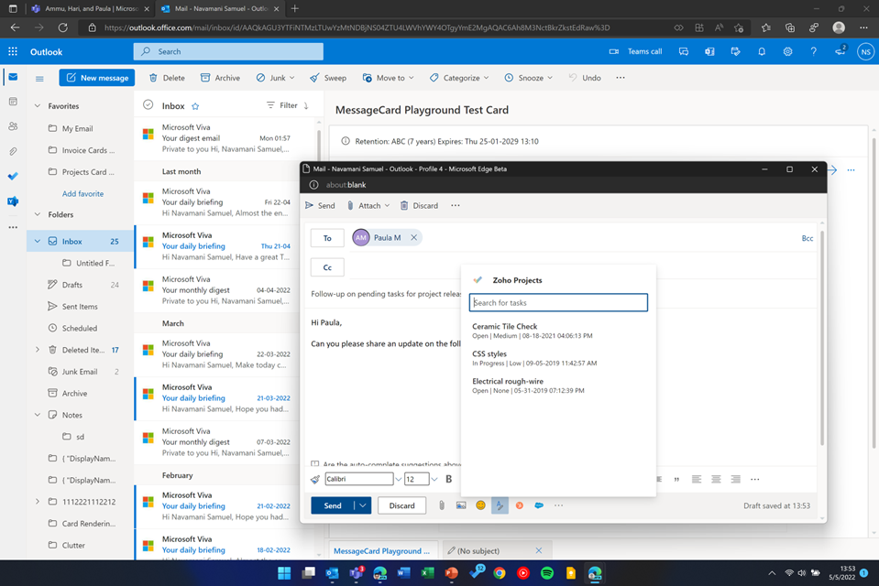
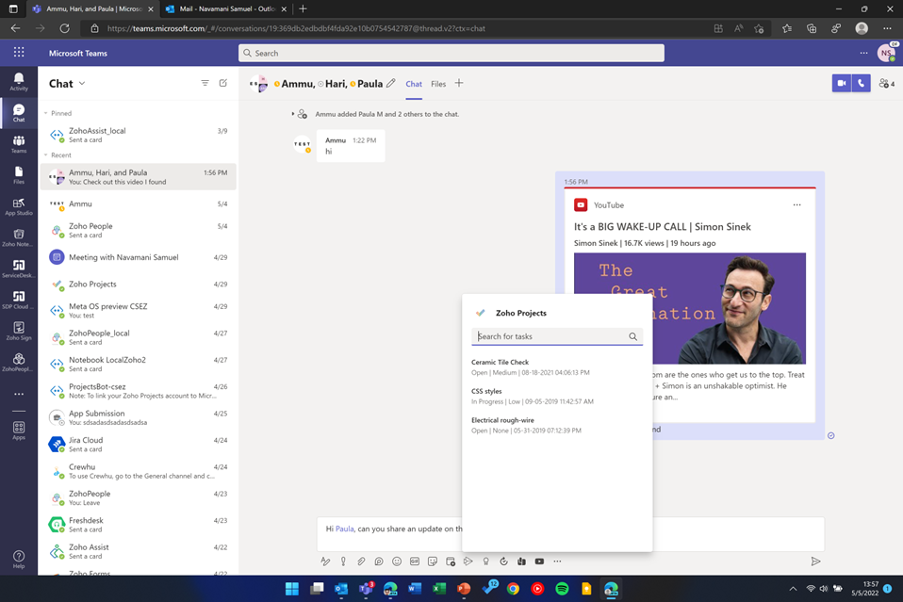
Zoho Examples

Slide 20
Teams Toolkit for Visual Studio Code
Generally available

Slide 21
Teams Toolkit for Visual Studio 2022
In preview

Slide 22
Collaboration Controls
Add many of the collaboration features of Microsoft 365 to your apps built with Power Apps
Coming soon

Slide 23
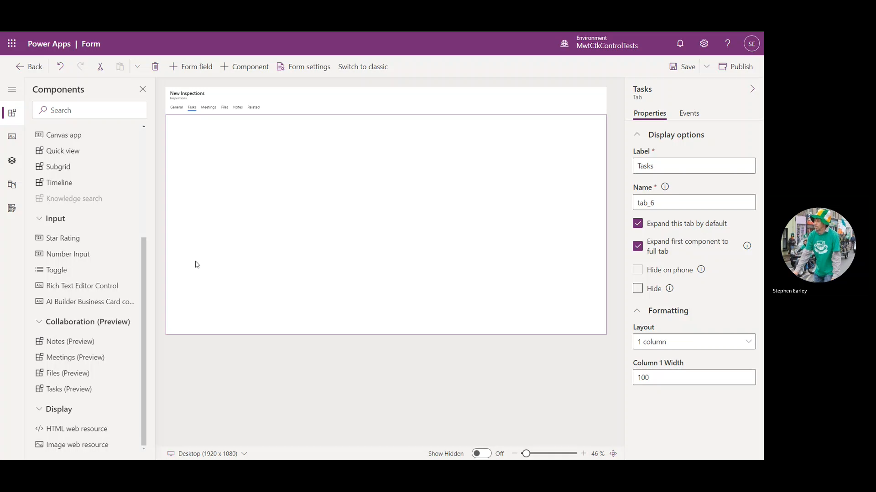
Preview - Using Collaboration controls with Modern Form Designer
Notes:
We don’t just want to simplify the user experience; we also want make to easy for all developers to build collaborative apps using the Collaboration controls.

Slide 24
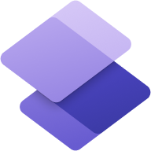







Microsoft Power Platform
Power Pages
Power BI
Business analytics
Power Apps
Application development
Power Automate
Workflow automation
Power Virtual Agents
Intelligent virtual agents
Dataverse
AI Builder
Power Fx

Slide 25
Microsoft Power Pages
Quickly and easily build modern, secure and responsive websites that scale
Announcing

Slide 26
Microsoft Teams app model updates

Slide 27











Teams App capabilities
Extend to Outlook and Office.com
Tabs & Personal Apps
Starting with these capabilities
Message Extensions
Bots
Meeting Extensions
Personal Apps
Search-based Message Extensions
Feed Notifications
Graph API
Share to Teams
Available on the Web and Windows
Mobile will fast follow later this calendar year
Webhooks & Connectors

Slide 28
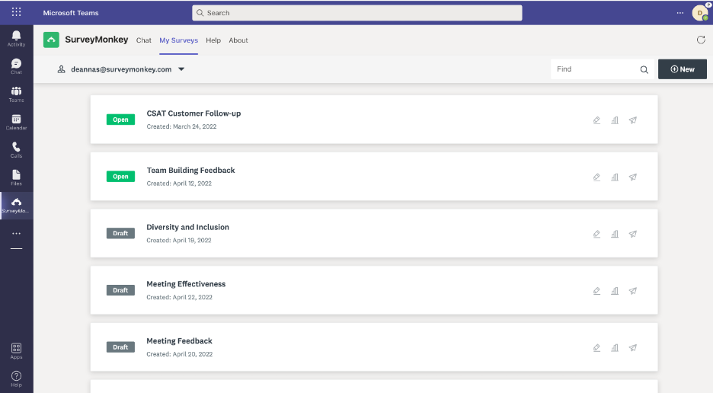

Slide 29
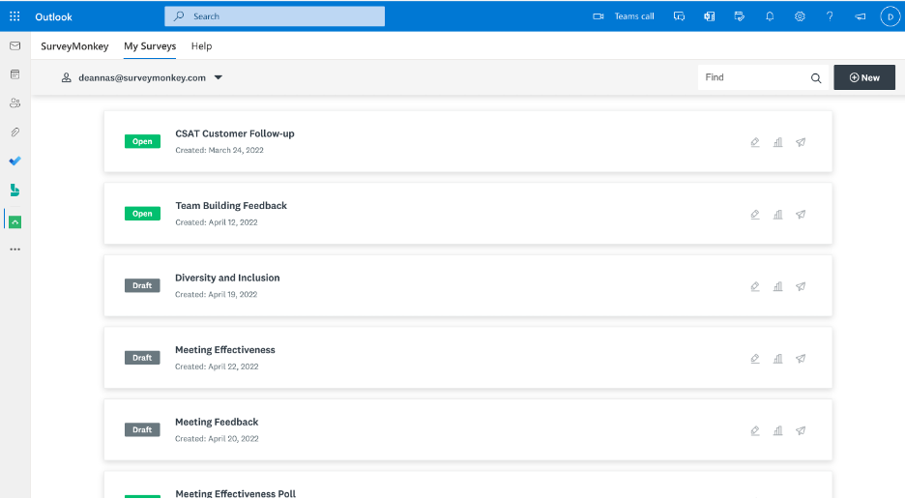

Slide 30
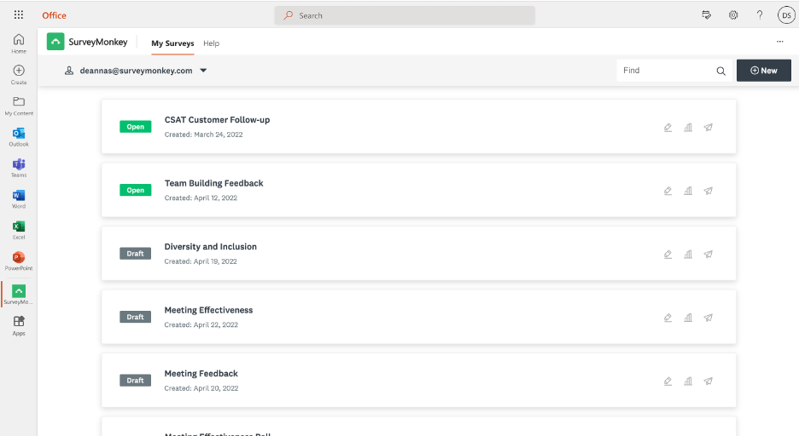

Slide 31
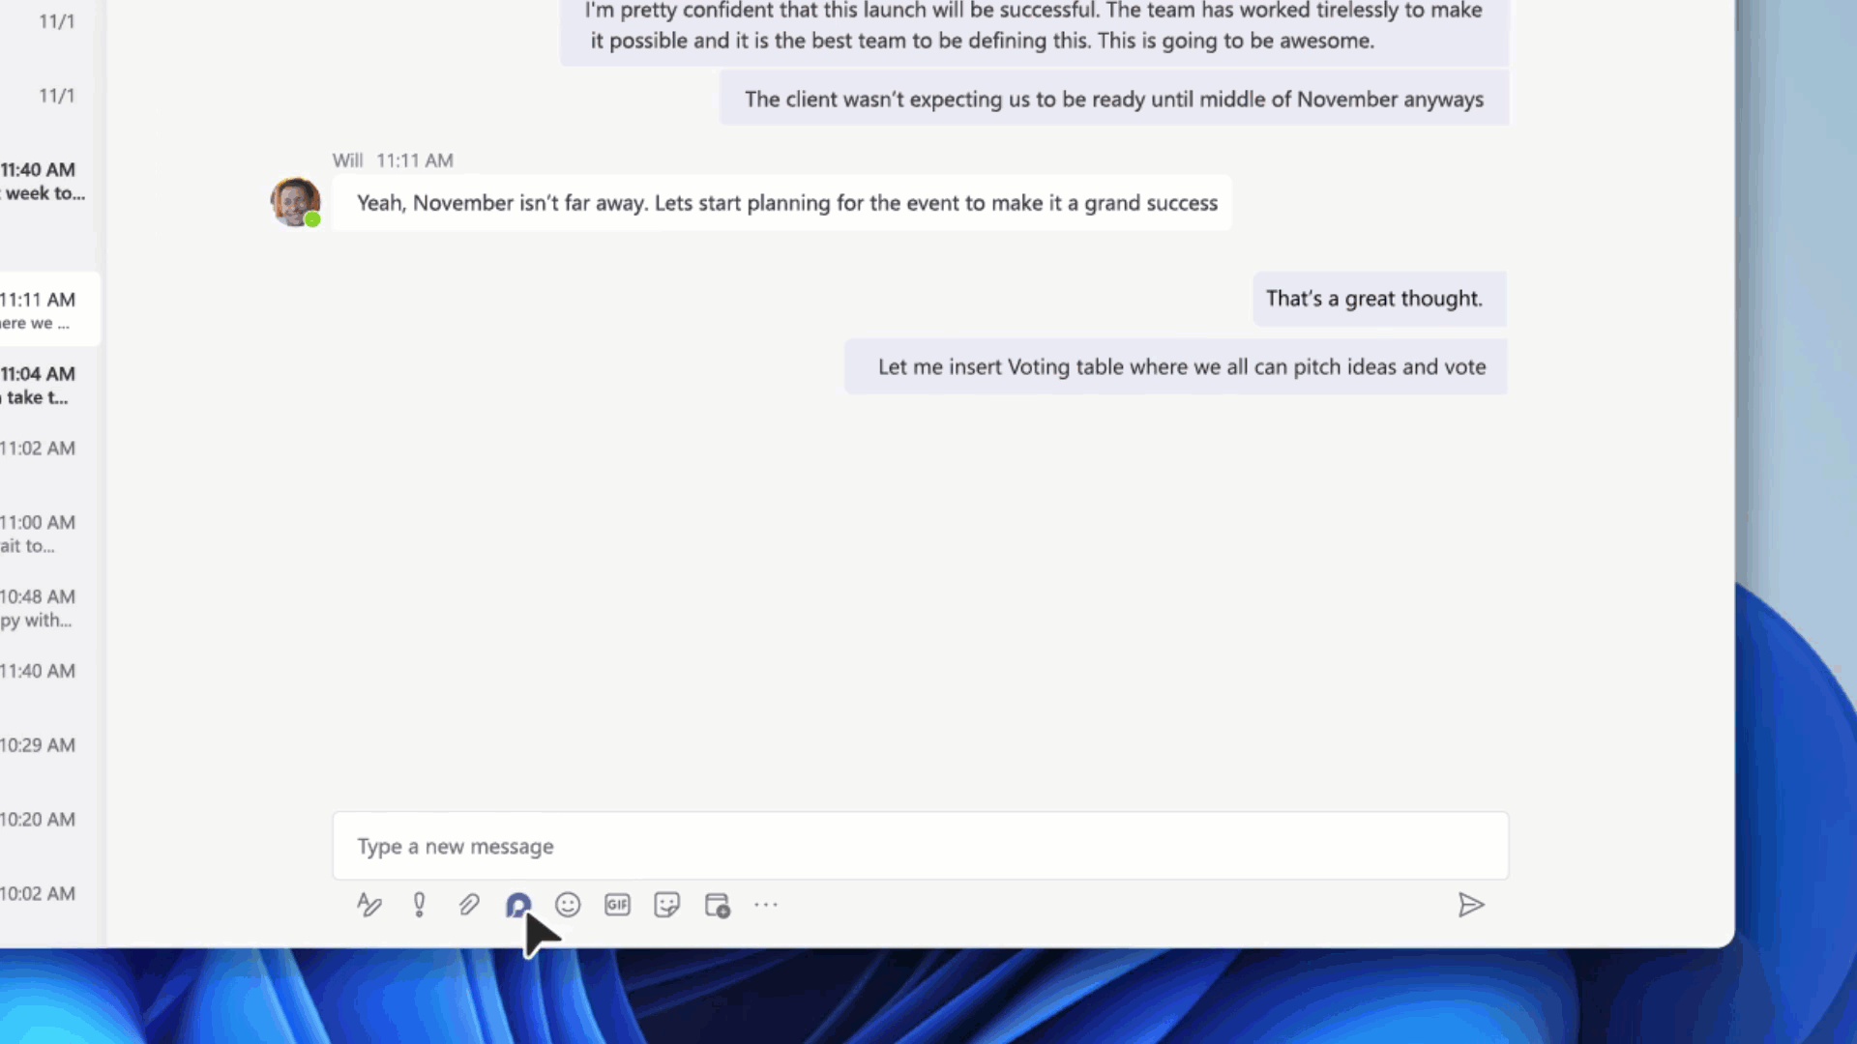
Loop components

Slide 32
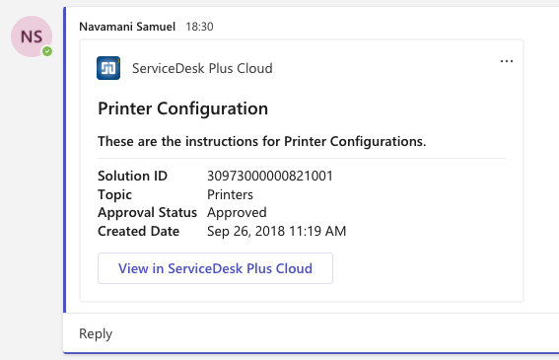
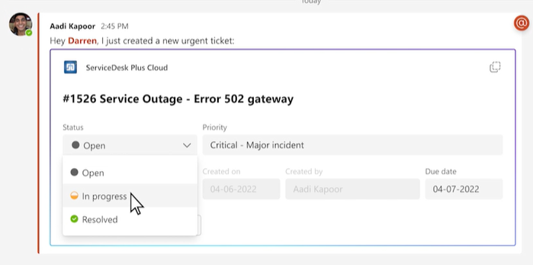
Adaptive Card-based Loop components
Old Adaptive Card
New Adaptive Card-based Loop component

Slide 33
Microsoft Teams Framework (TeamsFx)

Slide 34




Microsoft Teams Framework (TeamsFx)
> teamsfx new
SDKs
CLI
IDE extensions
Notes:
The primary parts of the framework - tools and libraries, are provided as SDKs, a CLI, and IDE extensions.

Slide 35
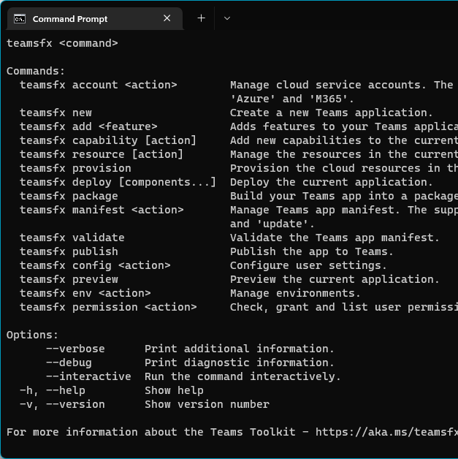
Teams Toolkit CLI
Notes:
The CLI can scaffold new apps using our JavaScript and TypeScript project templates for Teams.
You end up with a React app that includes some sample code, a Teams app manifest, and any of the Teams extensibility surfaces you select to add. The CLI also includes features for creating and managing cloud resources that host your Teams app features.

Slide 36
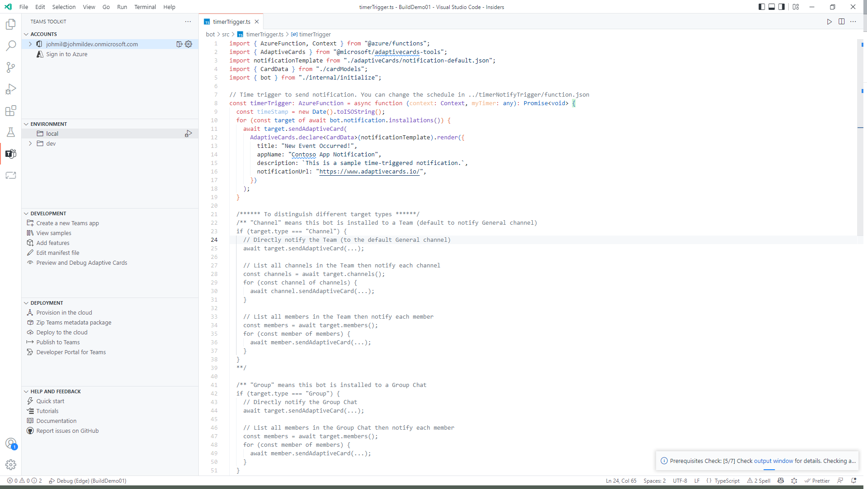
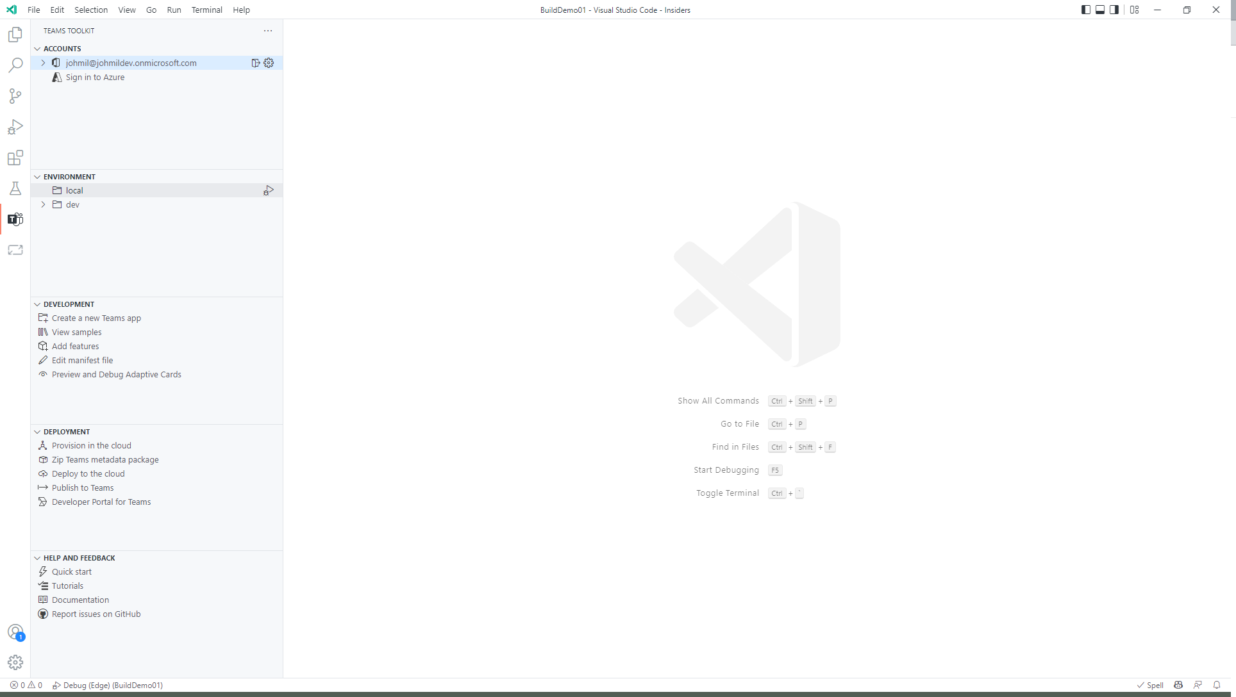
Teams Toolkit for Visual Studio Code
Notes:
We’ve built an extension for Visual Studio Code – Teams Toolkit for Visual Studio Code, to make it even easier to take advantage of the TeamsFx features and get started. The VS Code extension is designed to work with JavaScript and TypeScript projects.

Slide 37
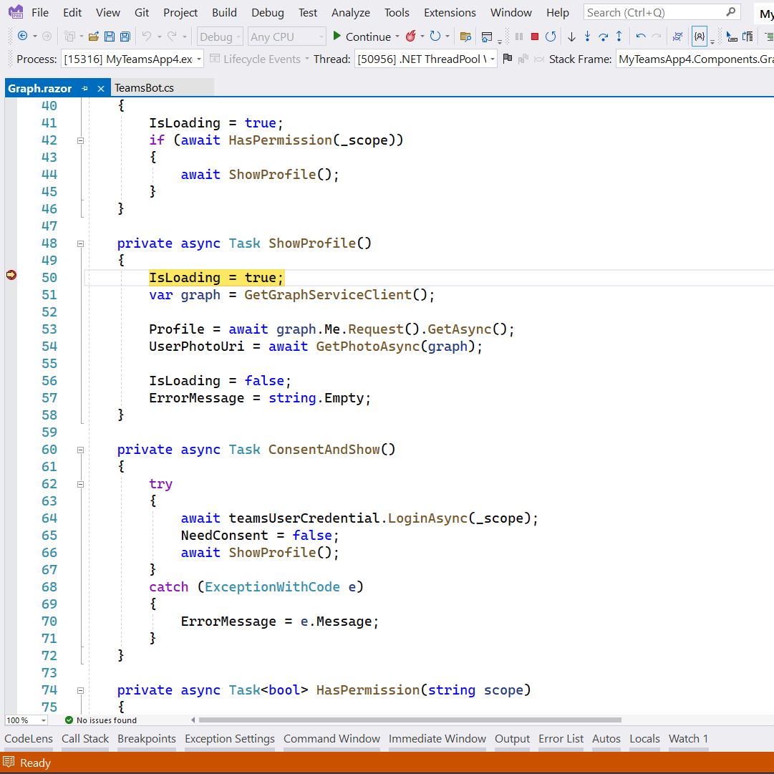
Teams Toolkit for Visual Studio
Notes:
For .NET developers, we’re focusing on our extension in Visual Studio 2022 – Teams Toolkit for Visual Studio, to provide support and tooling for using Blazor and ASP.NET Core for Teams app development.

Slide 38

General availability
In-app purchase aka.ms/TeamsMonetization/IAP
Coming soon
Integrated License Management

Slide 39
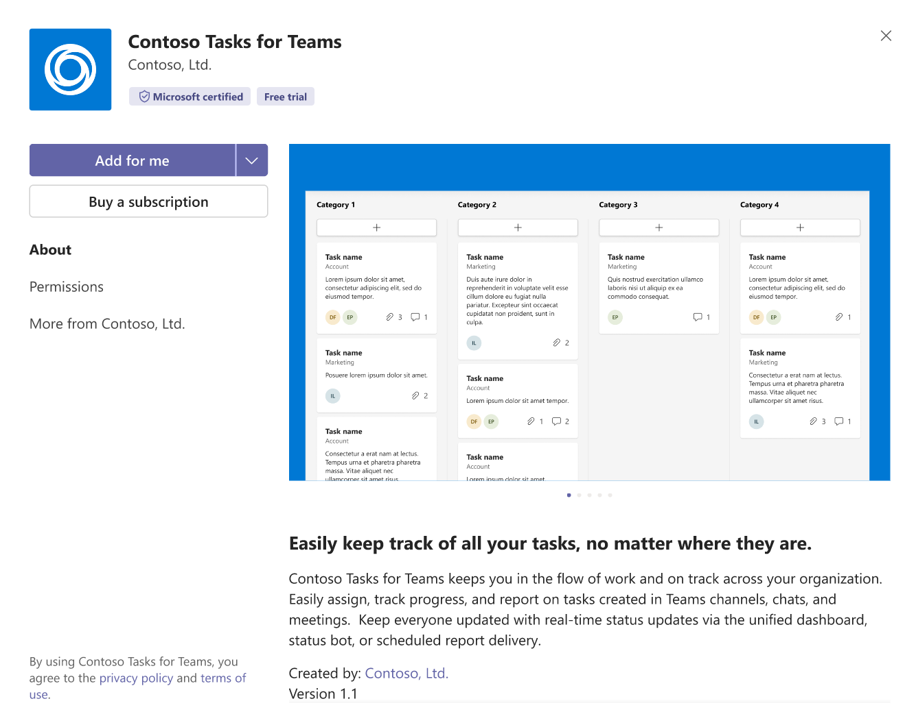

Slide 40
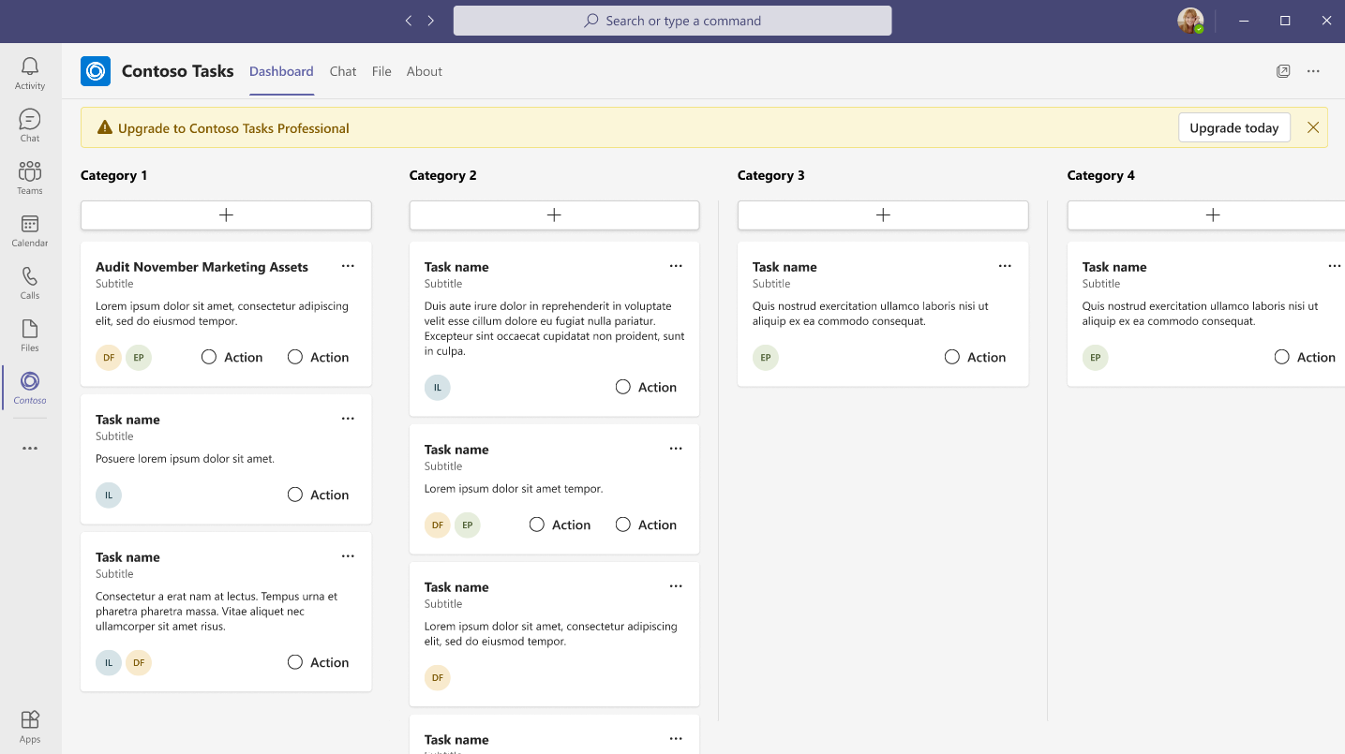

Slide 41
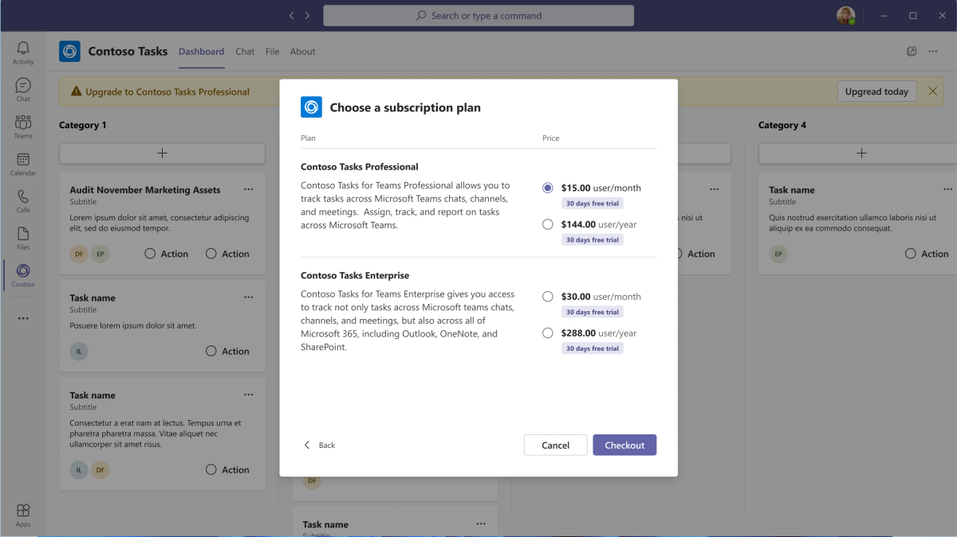

Slide 42
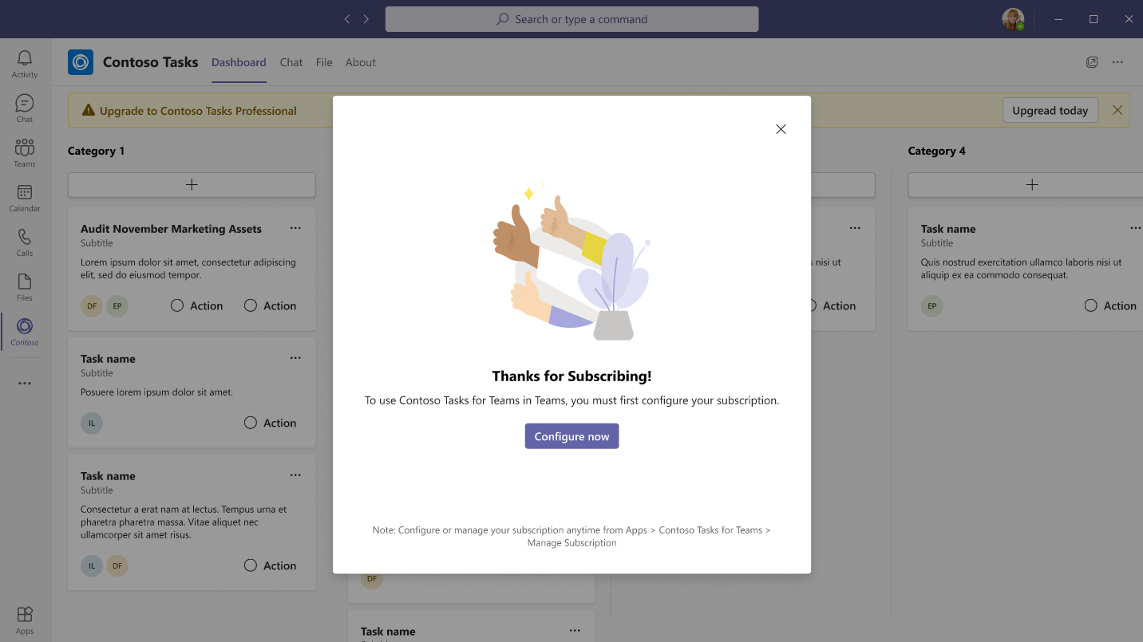

Slide 43
Microsoft Graph updates

Slide 44




Microsoft Graph Overview
REST APIs
Connectors
Data Connect
Microsoft Graph Data Connect
Bulk data access for insights and analytics over a time period
Microsoft Graph Connectors
M365 DATA
Data ingestion, enrichment, and indexing
Microsoft Graph APIs
HTTP API, real-time access to data
Microsoft Graph

Slide 45


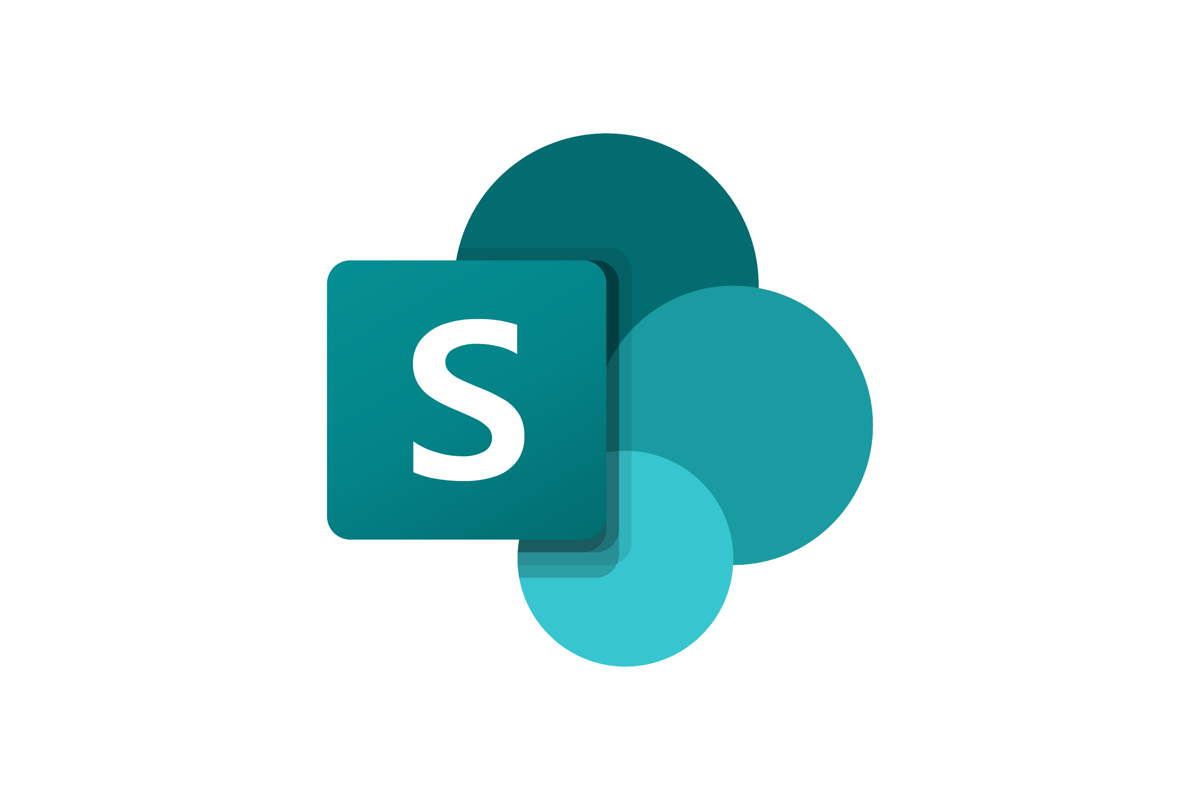
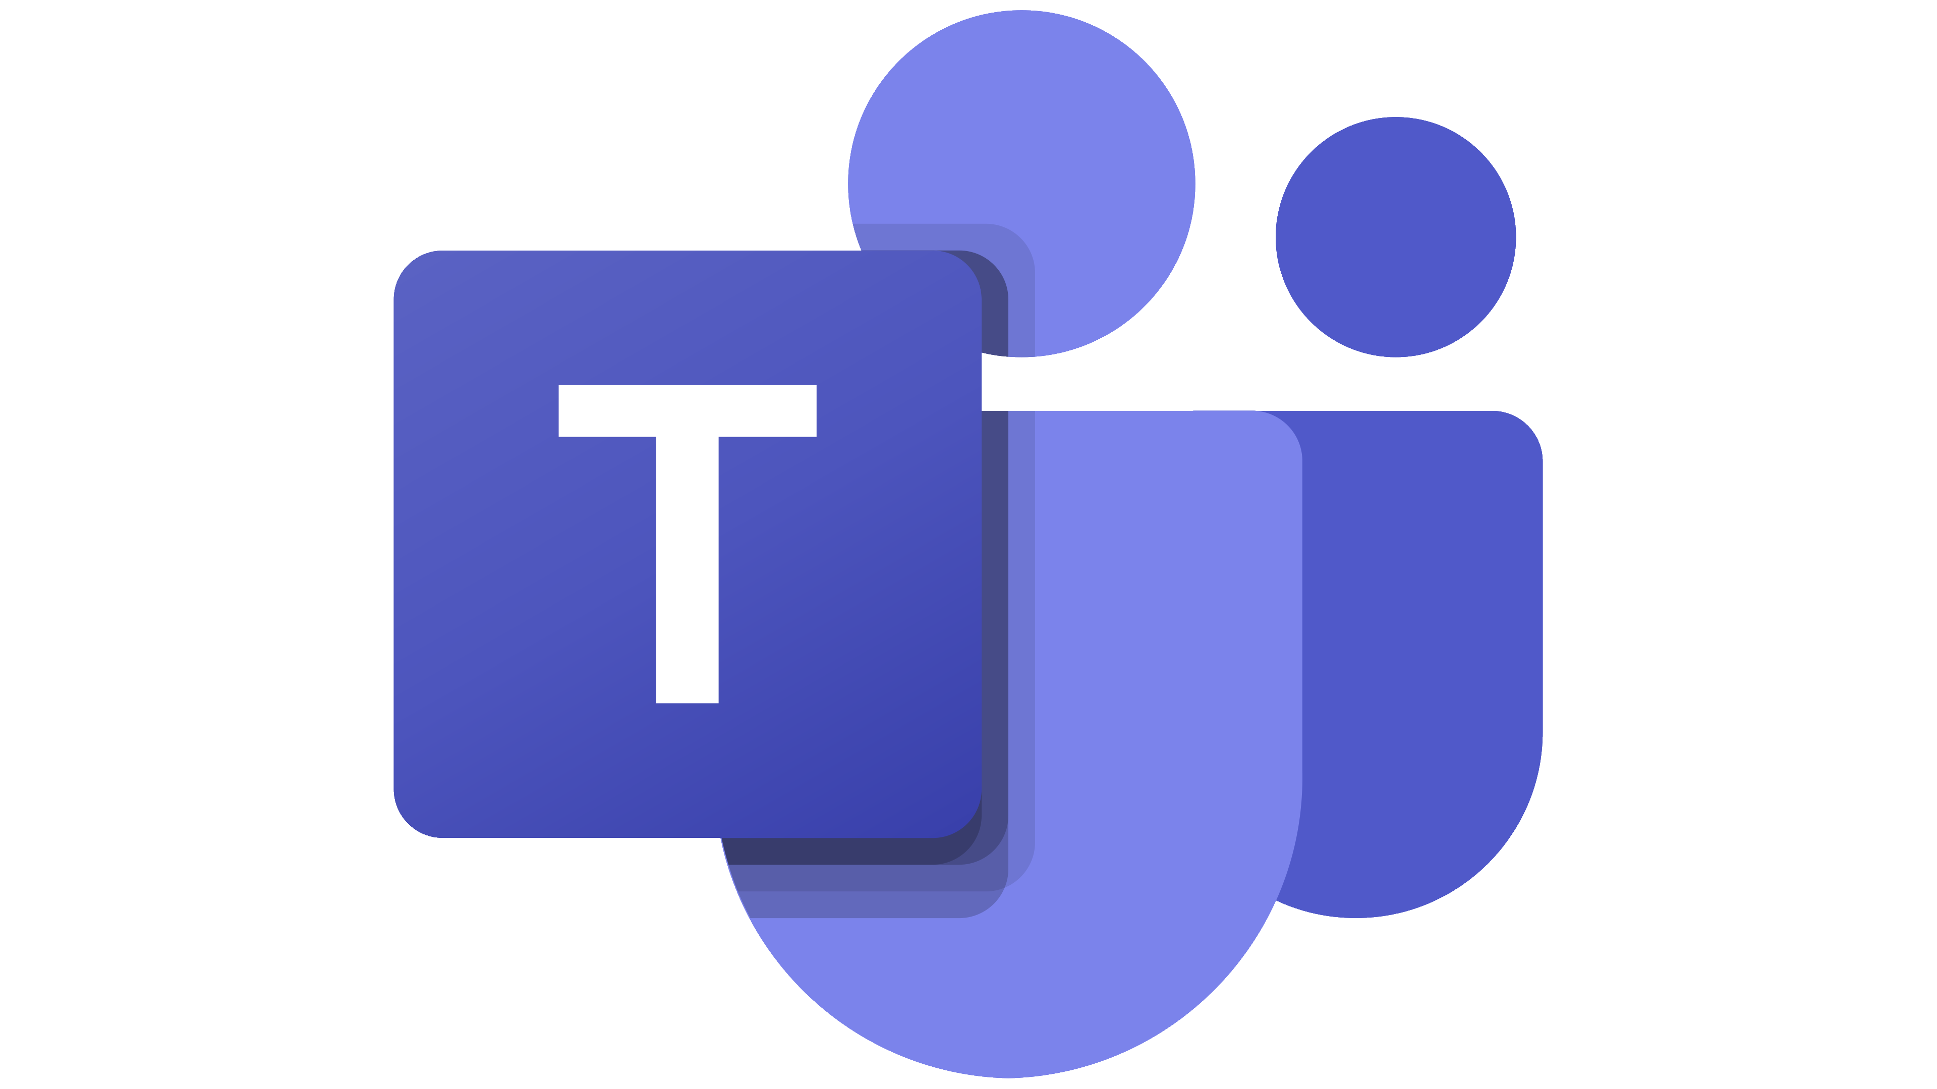

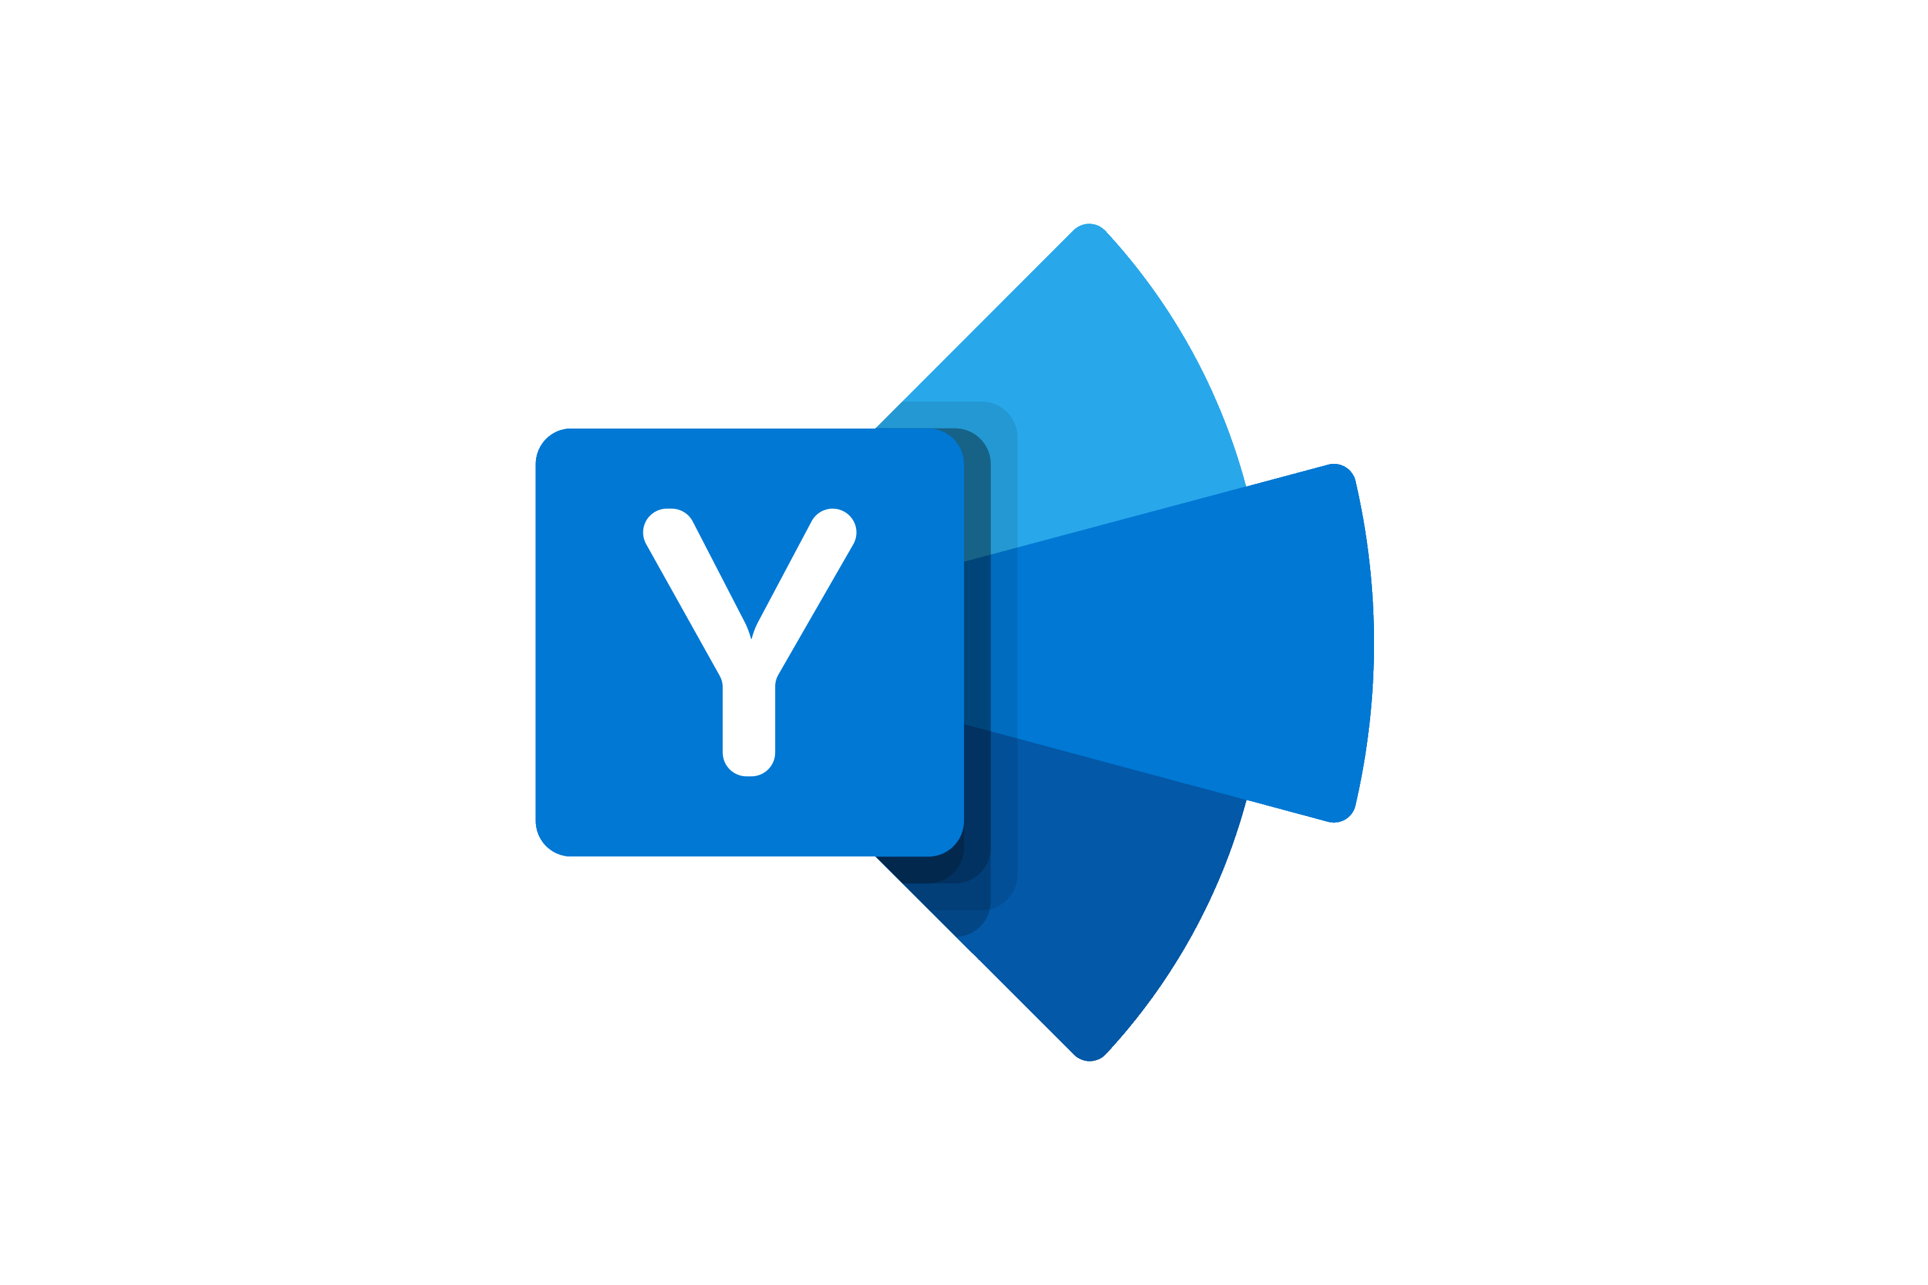
Microsoft Graph Data Connect – Roadmap slide from Build 2022
General Availability | Available in Preview | Future/Envisioned
Calendar View Contact Events (Calendar) Inbox (emails) Mail Folder Mailbox Settings Messages (emails) Sent Items (emails) Direct Report Group Details Group Members Group Owners Manager User Call Records Channel Details Chats (1:1 & group chats) Standard Channel Conversations | Group Conversations Viva Insights Analytics Document Sharing Information Sites Usage (Files & Items) Meeting Transcripts | Tasks Files & List Items Call Quality Data Private & shared channels’ conversations Community Details Conversations

Slide 46
New Microsoft Teams Graph API
Create chat
Send message
List chats
Get messages
Create a subscription

Slide 47











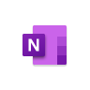

AI-powered, modern search for your workplace
Included with Microsoft 365
Relevant and personalized results
Data is always secured
Search from any device, anywhere
Microsoft Search
Notes:
But for Microsoft customers, there is good news. Microsoft Search, which is our AI-powered, modern search engine designed for organizations, is already included with your Microsoft 365 subscription.
It’s built on top of the Microsoft Graph and it takes into account user activities and relationship with the data to provide the most relevant and personalized search results.
Being an enterprise search product, security is critical. Microsoft Search supports security trimming to ensure only users who are supposed to see the data can see the search results.
And Microsoft Search meets you where you are by being available on multiple form factors, and multiple endpoints including Bing, SharePoint, Office.com and Windows Search Box.

Slide 48






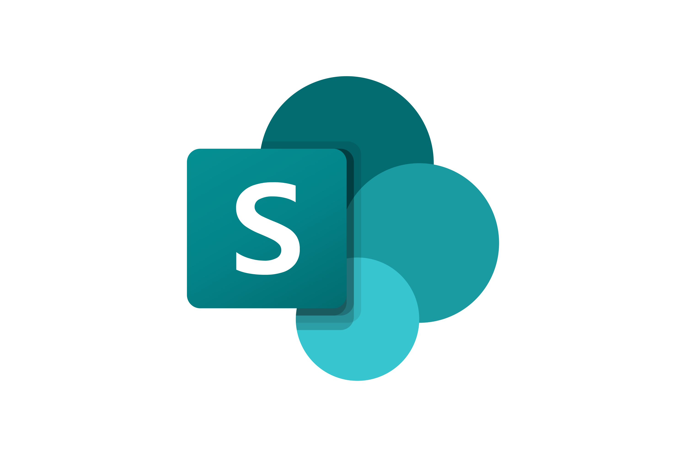






Graph connectors connect your data sources Microsoft Search
Over 130 data sources supported
APIs enable you to develop custom connectors
Microsoft Search
Notes:
And of course, with any enterprise search engine, connectors are important.
Microsoft Search will already index all your SharePoint online and OneDrive for work content, with zero setup.
But to increase your search completeness and coverage, you can use Graph connectors to connect to your SaaS data sources, your on-prem file shares, databases or content management systems, and any other custom line of business data sources, so Microsoft Search can index all of them and make the available for search.
Between Microsoft and our partners, there are over 130 connectors, and you can find them at the Graph connectors Gallery.
You can also use the Graph connectors API to develop your own connector. Whether you are implementing a custom connector for your organization, or if you are a SaaS vendor, wanting to make your product’s content searchable in Microsoft Search, these are the right APIs for you to use.

Slide 49
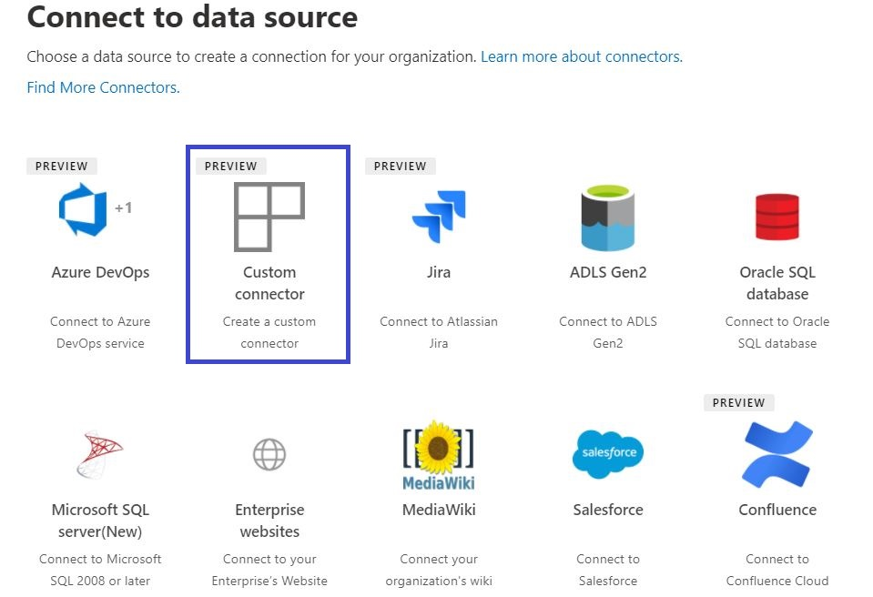
Graph connectors SDK
Build your own custom line-of-business connector
Develop: Write minimal code for just reading data and ACLs from the data source.
Following features are built-in:
Crawl scheduling & management
Identity management
Graph ingestion and more
Test: Use pre-built test scenarios
Deploy: Publish and manage your Microsoft built and custom connectors in a single place
Notes:
Now that you have seen how to build your custom connectors using Graph APIs accessible through the Microsoft Graph SDK, I’d like to announce that very soon, you’ll also be able to develop custom connectors using the Microsoft Graph connectors SDK- built specifically to help you develop your custom connectors efficiently.
You can quickly get started with the Graph connectors SDK by downloading our connector template and writing minimal code in up to 11 languages.
You’ll be able to leverage the in-built capabilities of our connector platform for crawl orchestration, Identity management, connection management and more.
You can also test your code using our test utility with pre-built test scenarios.
And finally, you can publish your connection through the M365 Admin center and leverage it as a single place to manage and monitor all your custom connectors as well as Microsoft built connectors.

Slide 50
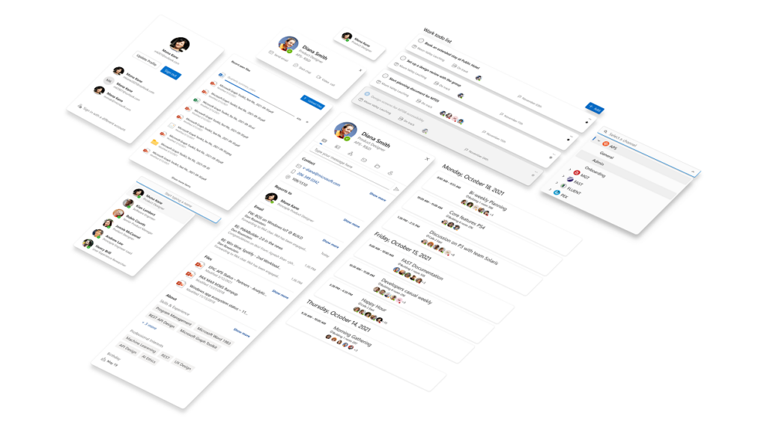
Other Microsoft Graph related updates
Updates on the https://graph.Microsoft.com
SDK updates - Kiota, our code generator for next generation OpenAPI based SDKs
Microsoft Graph Toolkit updates
New Microsoft Graph Learning Path - Explore Microsoft Graph scenarios for ASP.NET Core development
and more… 🚀

Slide 51
Latest on Viva Connections and SharePoint Framework

Slide 52





The Road Ahead – 1.15 Release – June 2022
Q2 CY 2022
Latest 1.15 preview release – RC out soon
New Action types for media and geolocation – Tutorial just published
Support for Microsoft Graph SDK V3
Bug fixes and adjustments based on GitHub issues
New customizers for add and edit list / library forms
Available later as we progress in 1.15 development
Adaptive Card Extensions card view caching
Adaptive Card Extensions Error Handler Method
Adaptive Card Extensions card view caching – move to GA
Leverage Teams OBO flow for SPFx components in Teams Web
Support for TypeScript V4
Support for Teams SDK v1.12.1
Enable Service Principal Registration in app acquisition flow
Isolated Adaptive Card Extensions (Beta)
Post 1.15
Bots Powered Adaptive Card Extensions (Beta)**
Support for Node V16 – Delayed unfortunately due to dependency on Office UI Fabric/Fluent version used in SharePoint Online

Slide 53



Bot powered Viva Connections cards Preview as part of the SPFx 1.15 release – Use your existing Microsoft Teams investments to power ACEs
// tab/fetch POST request: agents/{botId}/invoke
{
"name": “botInvoke/QuickView",
“view” : ‘[…]’
}
// tab/fetch **continue** POST response:
{
"type": "AdaptiveCard",
"body": [
{
"type": "Container",
"style": "emphasis",
"items": [
{
"type": "ColumnSet",
"columns": [
{
"type": "Column",
"items": [
{
"type": "TextBlock",
"size": "Large",
"weight": "Bolder",
"text": "**EXPENSE APPROVAL**",
"wrap": true,
"style": "heading"
}
],
"width": "stretch"
},
[…]
}

Slide 54
Resources and blog posts to catch up on the announcements
On-demand videos from https://build.microsoft.com
Jeff Teper and & Charles Lamanna - Innovate with collaborative apps and low code
Microsoft Build 2022 – Book of News https://news.microsoft.com/build-2022-book-of-news/
All Microsoft 365 Platform sessions and details for consumption from https://aka.ms/m365/build22
Build collaborative apps with Microsoft Teams – Jeff Teper
Announcing Microsoft Power Pages: Build secure, low-code websites – Charles Lamanna
Microsoft Graph @ Build 2022 – Ben Summers
Introducing Live Share: Interactive app experiences in Microsoft Teams meetings – Hal Bond
What’s new for Office Add-ins at Build 2022 – Microsoft
Increase engagement and discoverability of your data with Microsoft Graph connectors – James Lau
Microsoft Teams Toolkit for Visual Studio Code now generally available – Tomomi Imura

Slide 55
Thank you
Recording will be available in 24 hours on
Microsoft 365 Community (PnP) YouTube channel
https://aka.ms/M365PnP/videos
(subscribe today)
Follow us on Twitter
@Microsoft365Dev | @M365PnP
Next Microsoft 365 Platform call: June 7th at 08:00 am PT
All available community calls from https://aka.ms/m365/calls

Slide 56



aka.ms/m365pnp

